Slide 1
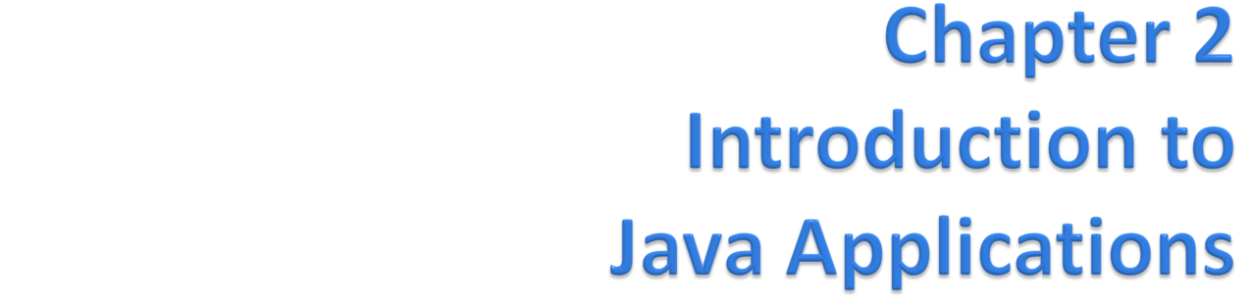
Java™ How to Program, 9/e
© Copyright 1992-2012 by Pearson Education, Inc. All Rights Reserved.

Slide 2
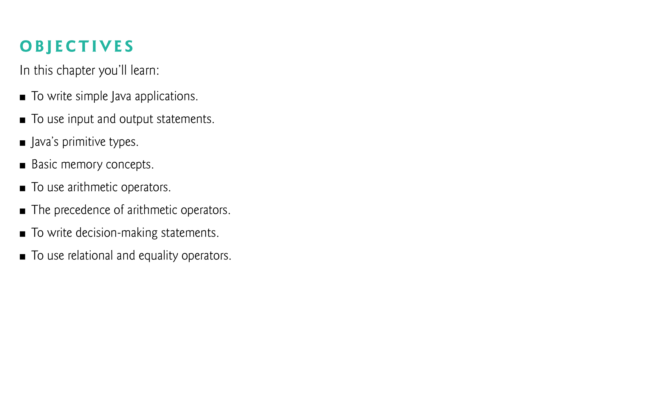
© Copyright 1992-2012 by Pearson Education, Inc. All Rights Reserved.

Slide 3
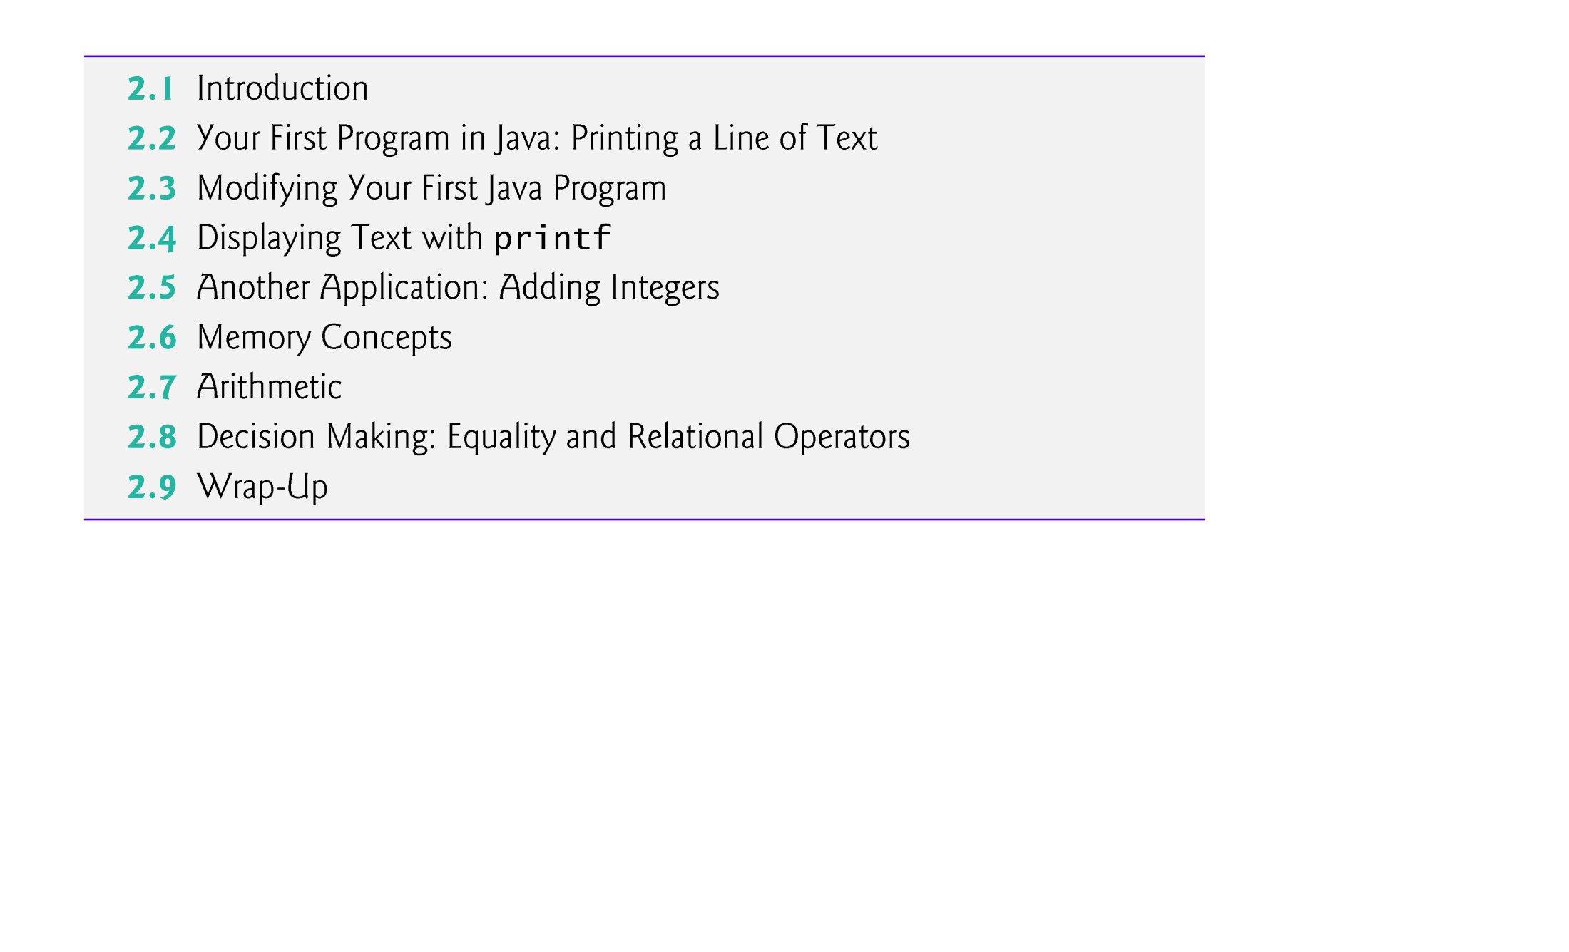
© Copyright 1992-2012 by Pearson Education, Inc. All Rights Reserved.

Slide 4
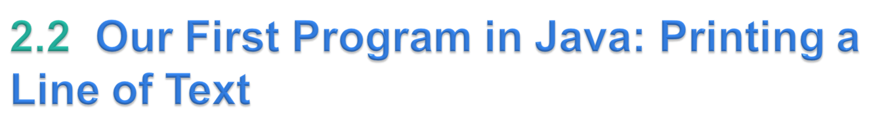
Java application
  A computer program that executes when you use the java command to launch the Java Virtual Machine (JVM).
Sample program in Fig. 2.1 displays a line of text.
© Copyright 1992-2012 by Pearson Education, Inc. All Rights Reserved.

Slide 5
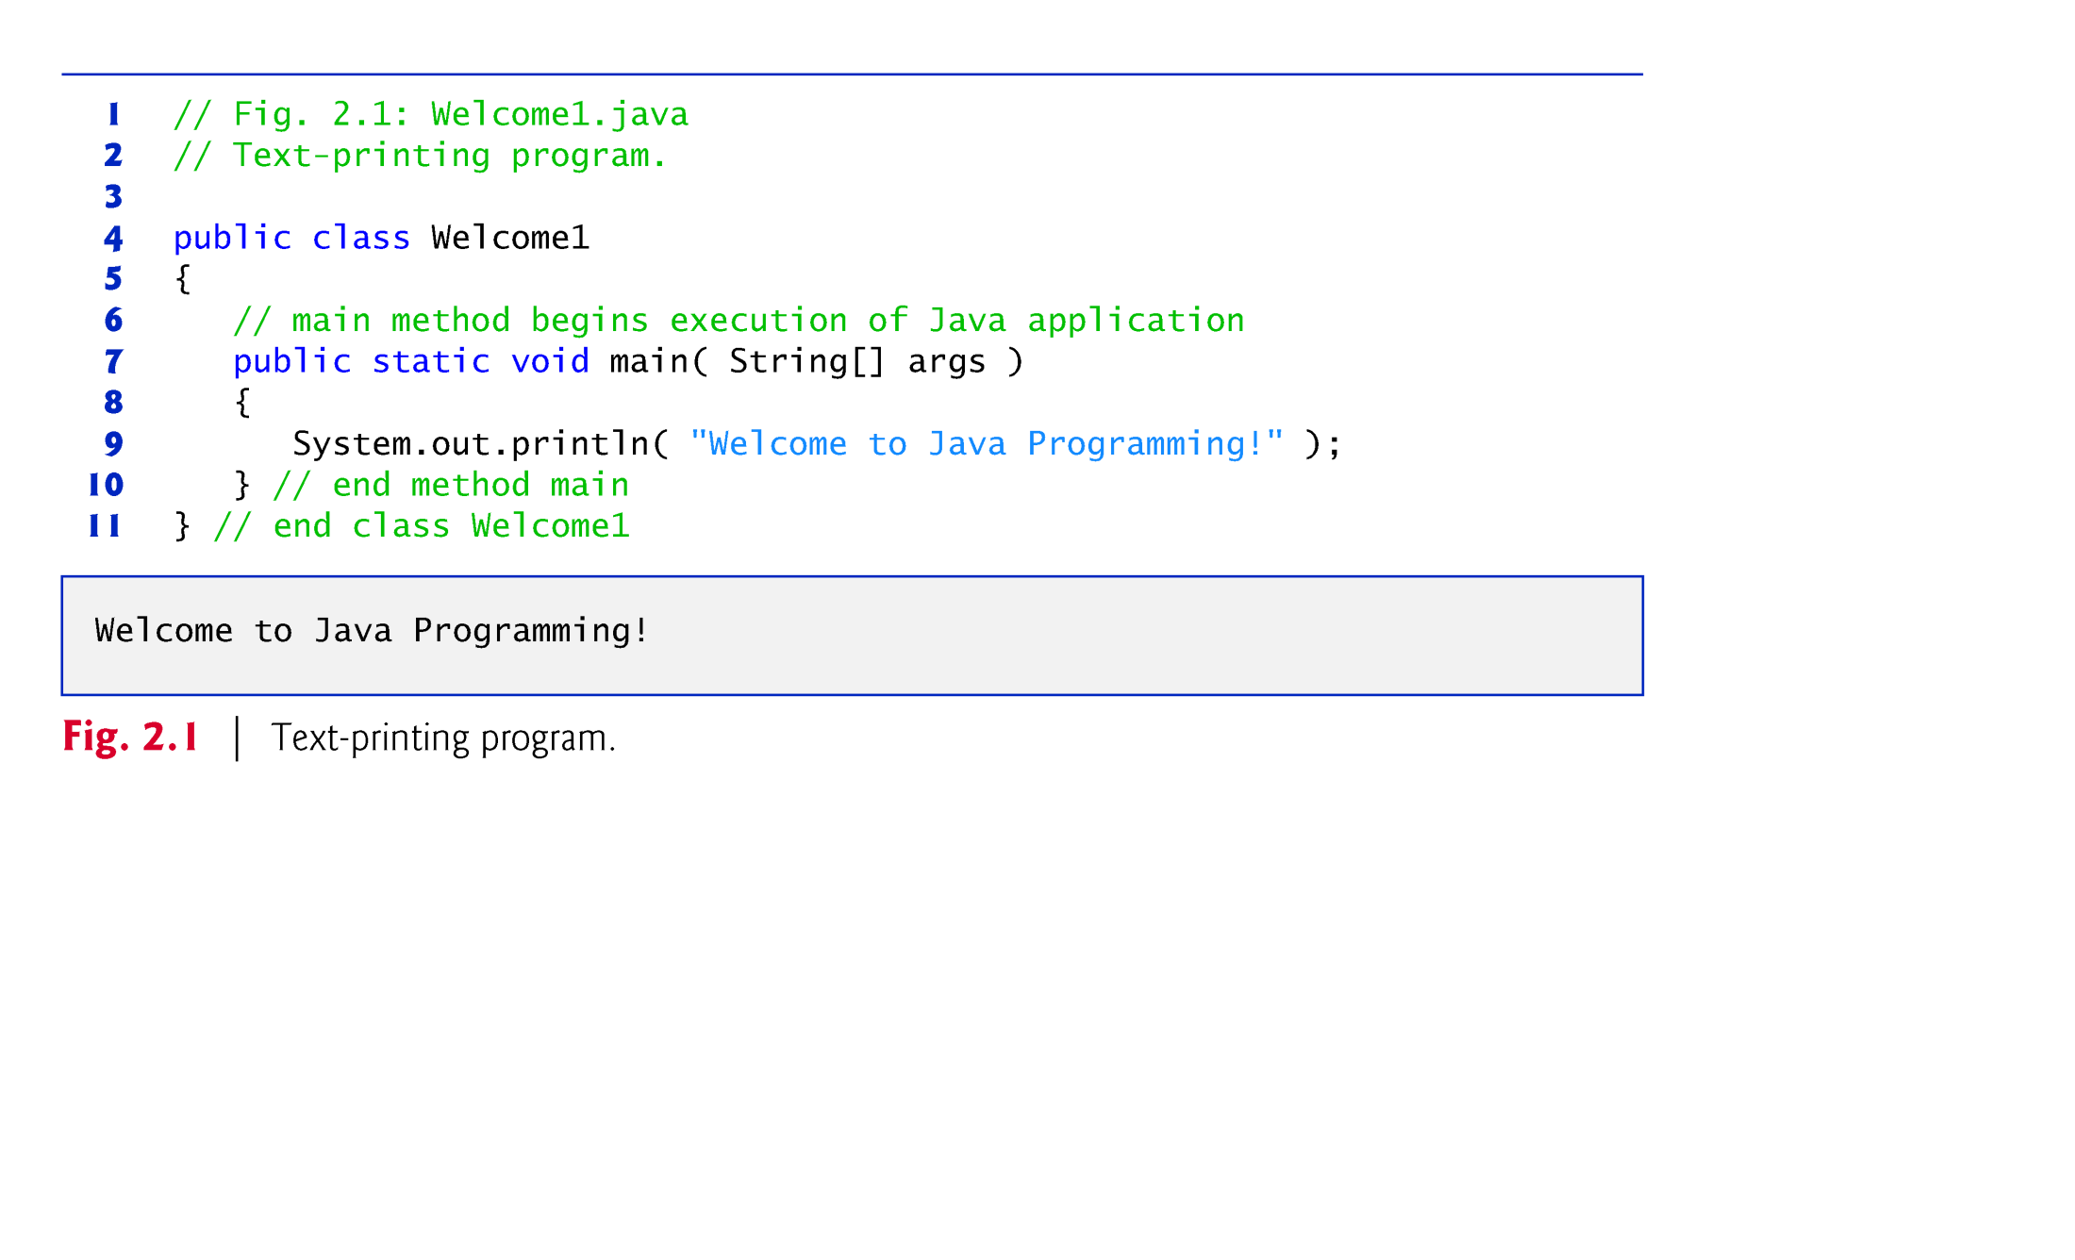
© Copyright 1992-2012 by Pearson Education, Inc. All Rights Reserved.

Slide 6
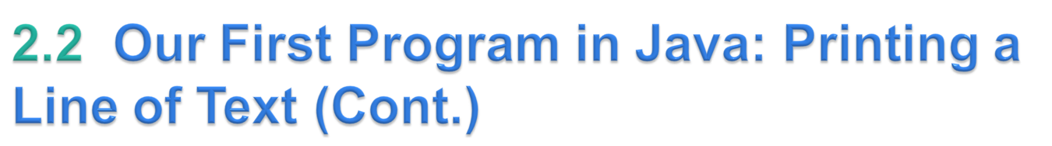
Comments
    // Fig. 2.1: Welcome1.java
  // indicates that the line is a comment.
  Used to document programs and improve their readability.
  Compiler ignores comments.
  A comment that begins with // is an end-of-line comment—it terminates at the end of the line on which it appears.
Traditional comment, can be spread over several lines as in
    /* This is a traditional comment. It
    can be split over multiple lines */
  This type of comment begins with /* and ends with */.
  All text between the delimiters is ignored by the compiler.
© Copyright 1992-2012 by Pearson Education, Inc. All Rights Reserved.

Slide 7
Blank lines and space characters
  Make programs easier to read.
  Blank lines, spaces and tabs are known as white space (or whitespace).
  White space is ignored by the compiler.
© Copyright 1992-2012 by Pearson Education, Inc. All Rights Reserved.

Slide 8
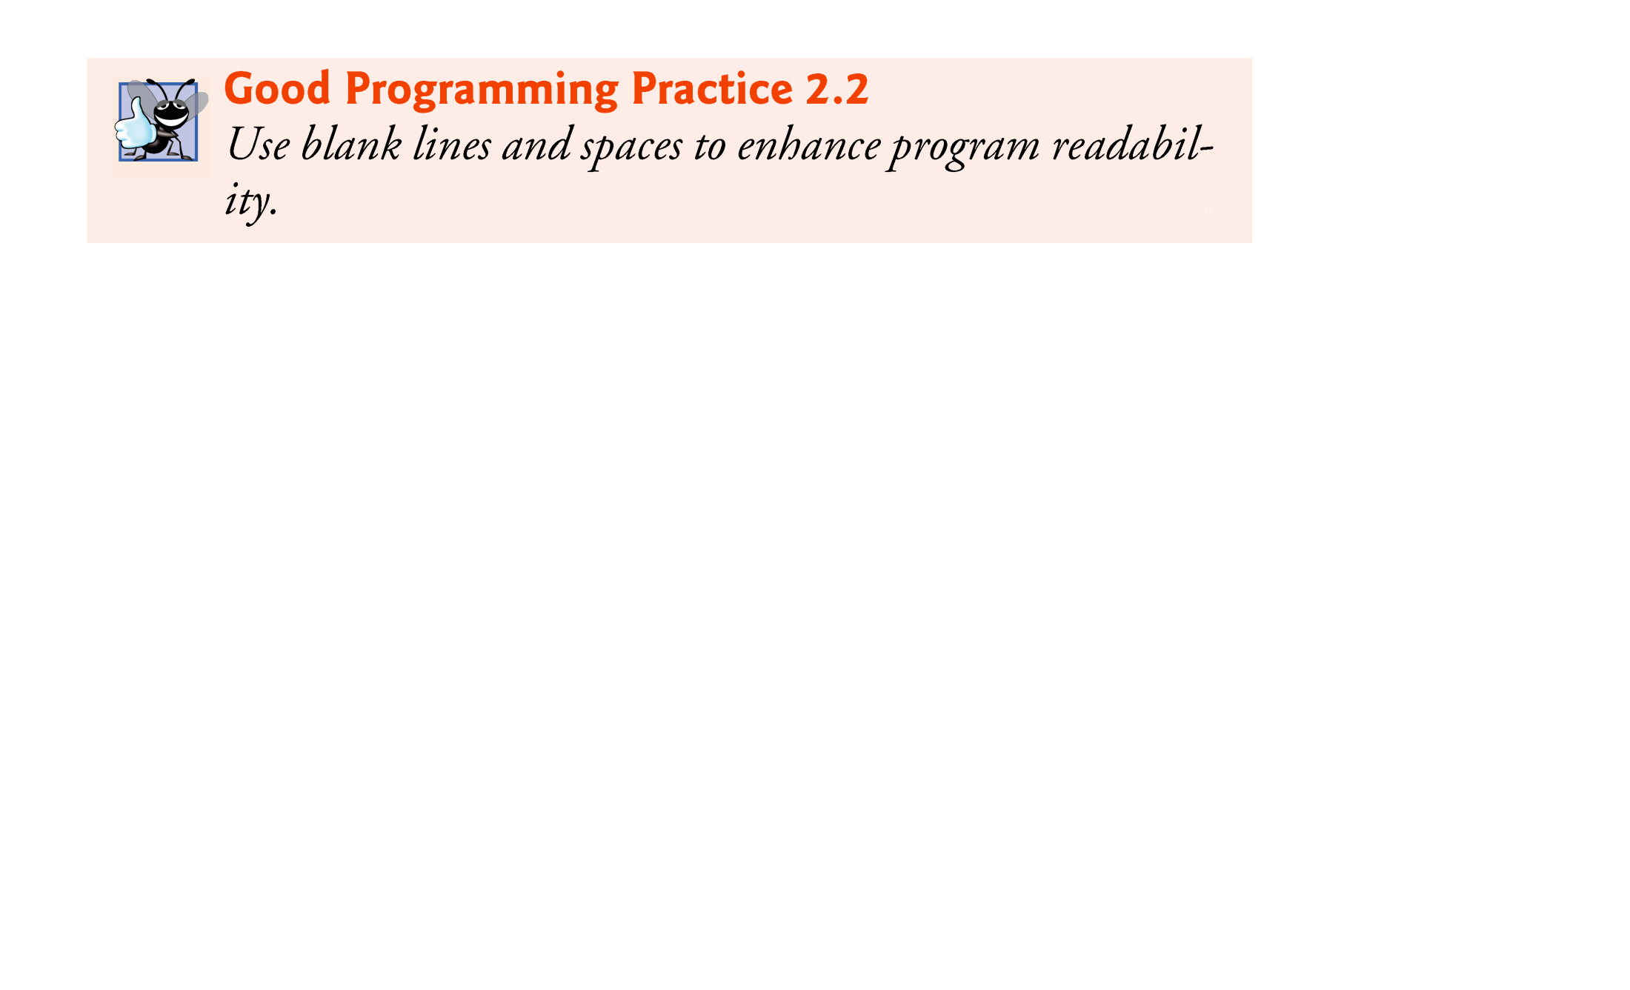
© Copyright 1992-2012 by Pearson Education, Inc. All Rights Reserved.

Slide 9
Class declaration
    public class Welcome1
  Every Java program consists of at least one class that you define.
  class keyword introduces a class declaration and is immediately followed by the class name.
  Keywords are reserved for use by Java and are always spelled with all lowercase letters.
© Copyright 1992-2012 by Pearson Education, Inc. All Rights Reserved.

Slide 10
Class names
  By convention, begin with a capital letter and capitalize the first letter of each word they include (e.g., SampleClassName).
  A class name is an identifier—a series of characters consisting of letters, digits, underscores (_) and dollar signs ($) that does not begin with a digit and does not contain spaces.
  Java is case sensitive—uppercase and lowercase letters are distinct—so a1 and A1 are different (but both valid) identifiers.
© Copyright 1992-2012 by Pearson Education, Inc. All Rights Reserved.

Slide 11
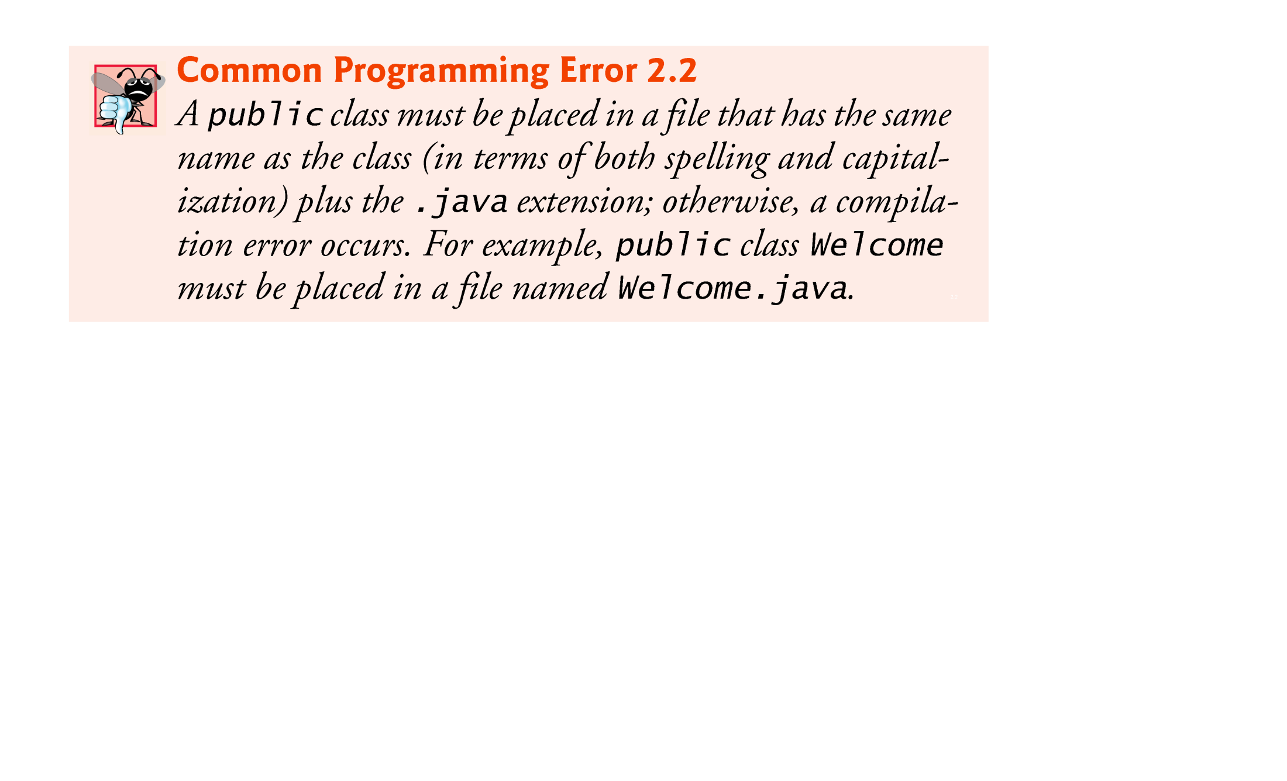
© Copyright 1992-2012 by Pearson Education, Inc. All Rights Reserved.

Slide 12
Braces
  A left brace, {, begins the body of every class declaration.
  A corresponding right brace, }, must end each class declaration.
  Code between braces should be indented.
  This indentation is one of the spacing conventions mentioned earlier.
© Copyright 1992-2012 by Pearson Education, Inc. All Rights Reserved.

Slide 13
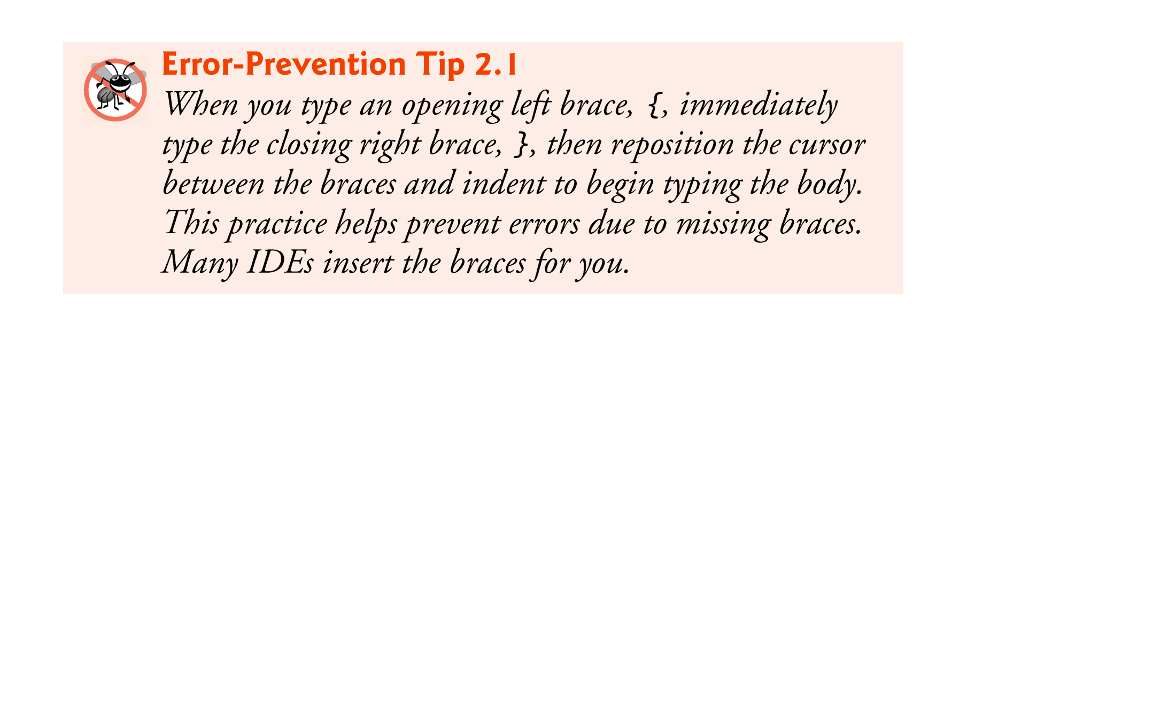
© Copyright 1992-2012 by Pearson Education, Inc. All Rights Reserved.

Slide 14

© Copyright 1992-2012 by Pearson Education, Inc. All Rights Reserved.

Slide 15
Declaring the main Method
    public static void main( String[] args )
  Starting point of every Java application.
  Parentheses after the identifier main indicate that it’s a program building block called a method.
  Java class declarations normally contain one or more methods.
  main must be defined as shown; otherwise, the JVM will not execute the application.
  Methods perform tasks and can return information when they complete their tasks.
  Keyword void indicates that this method will not return any information.
© Copyright 1992-2012 by Pearson Education, Inc. All Rights Reserved.

Slide 16
Body of the method declaration
  Enclosed in left and right braces.
Statement
    System.out.println("Welcome to Java Programming!");
  Instructs the computer to perform an action
    Print the string of characters contained between the double quotation marks.
  A string is sometimes called a character string or a string literal.
  White-space characters in strings are not ignored by the compiler.
  Strings cannot span multiple lines of code.
© Copyright 1992-2012 by Pearson Education, Inc. All Rights Reserved.

Slide 17
System.out object
  Standard output object.
  Allows Java applications to display strings in the command window from which the Java application executes.
System.out.println method
  Displays (or prints) a line of text in the command window.
  The string in the parentheses is the argument to the method.
  Positions the output cursor at the beginning of the next line in the command window.
Most statements end with a semicolon.
© Copyright 1992-2012 by Pearson Education, Inc. All Rights Reserved.

Slide 18
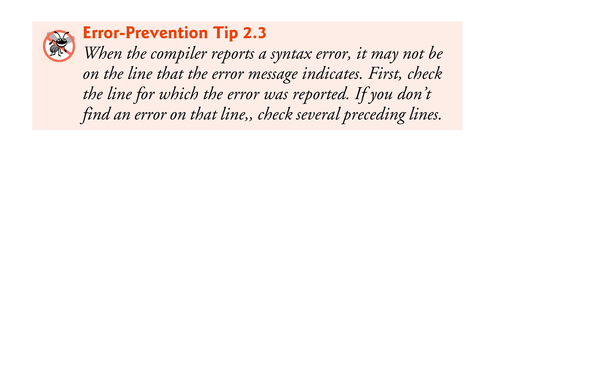
© Copyright 1992-2012 by Pearson Education, Inc. All Rights Reserved.

Slide 19
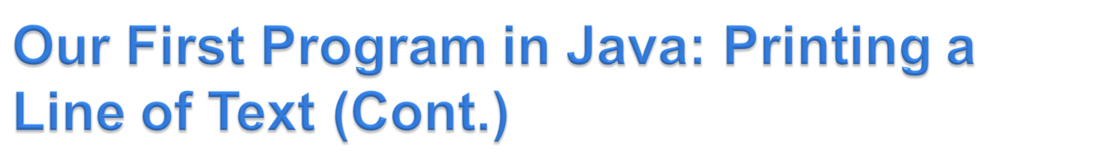

We will use the Eclipse IDE to compile and execute our first java program.
Other methods do exit for compilation/execution. See a few next hidden slides in the sequence.
Compiling and Executing Your First Java Application
  Create a new Java Project: File→New→Java Project
  Given the project the name you like.
  The window on next slide will appear.
  Write your code (main method with a print statement)
  Compile/execute using the play button on toolbar.
  The output is seen in the console window as shown
  In the next-to-next slide.
© Copyright 1992-2012 by Pearson Education, Inc. All Rights Reserved.

Slide 20
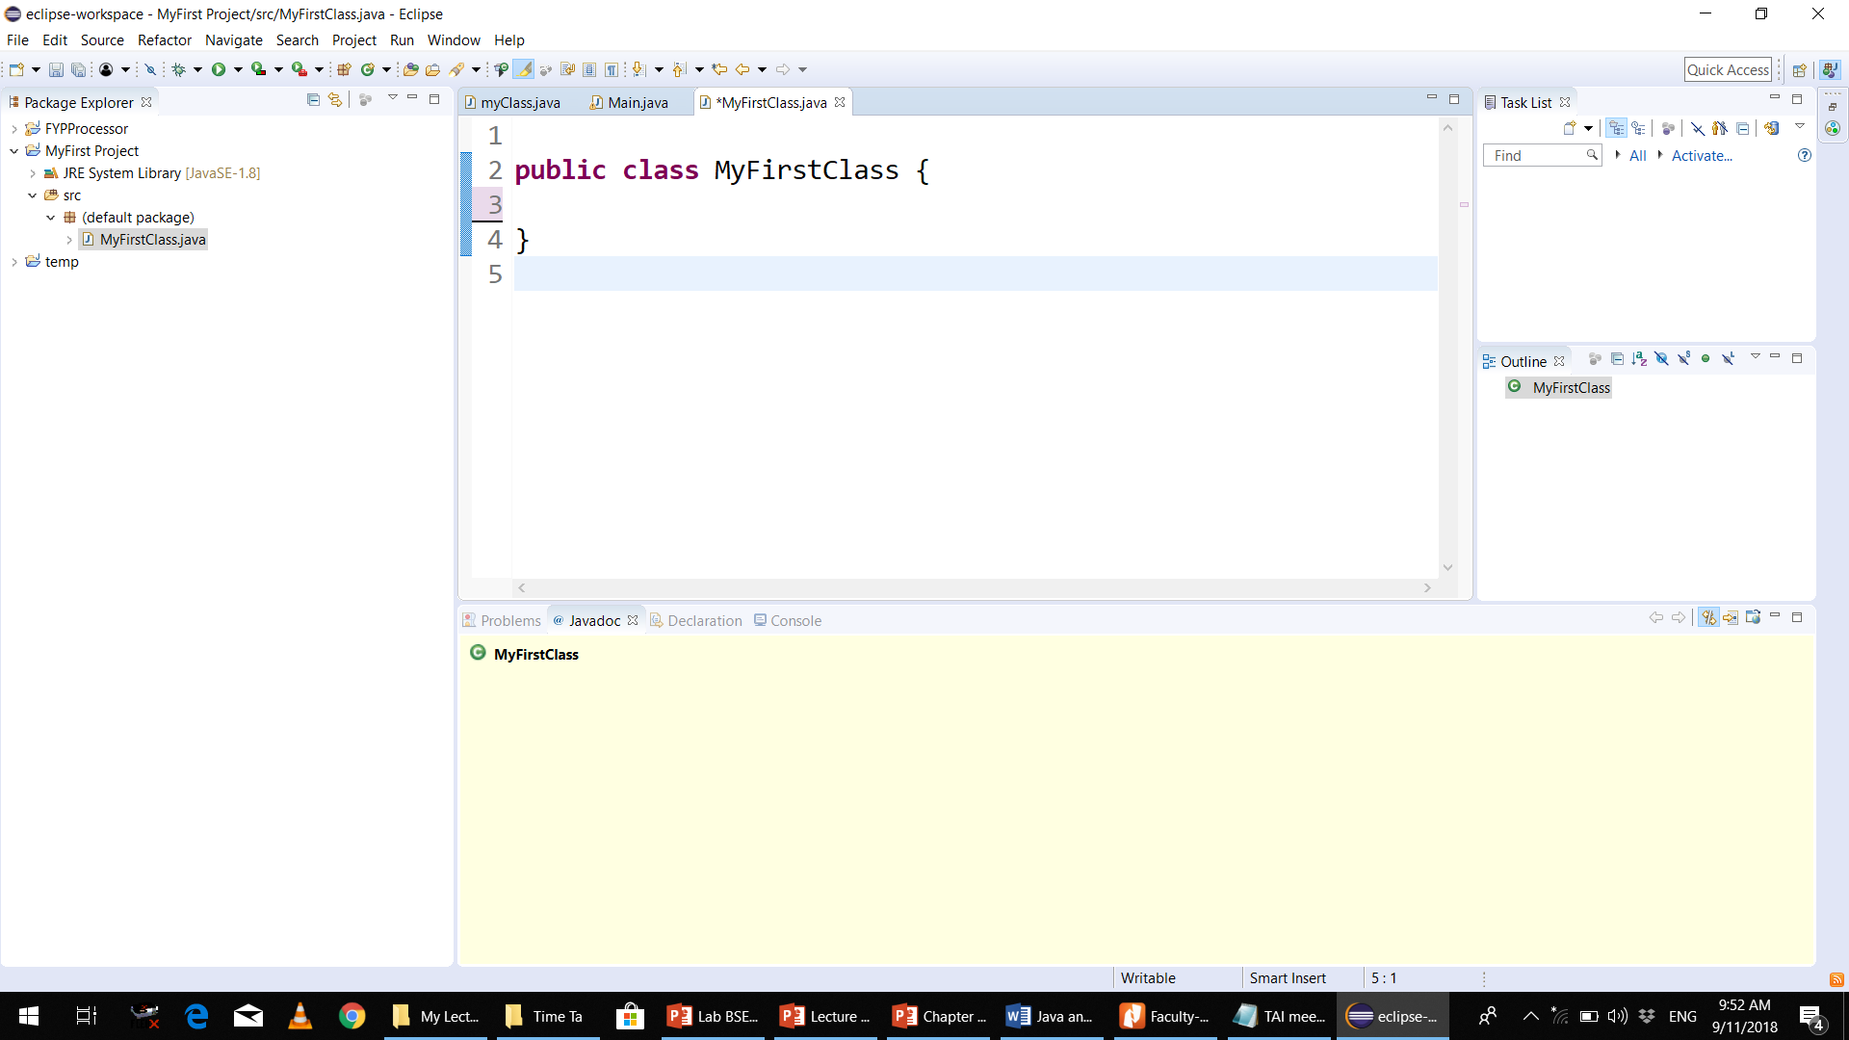
© Copyright 1992-2012 by Pearson Education, Inc. All Rights Reserved.

Slide 21
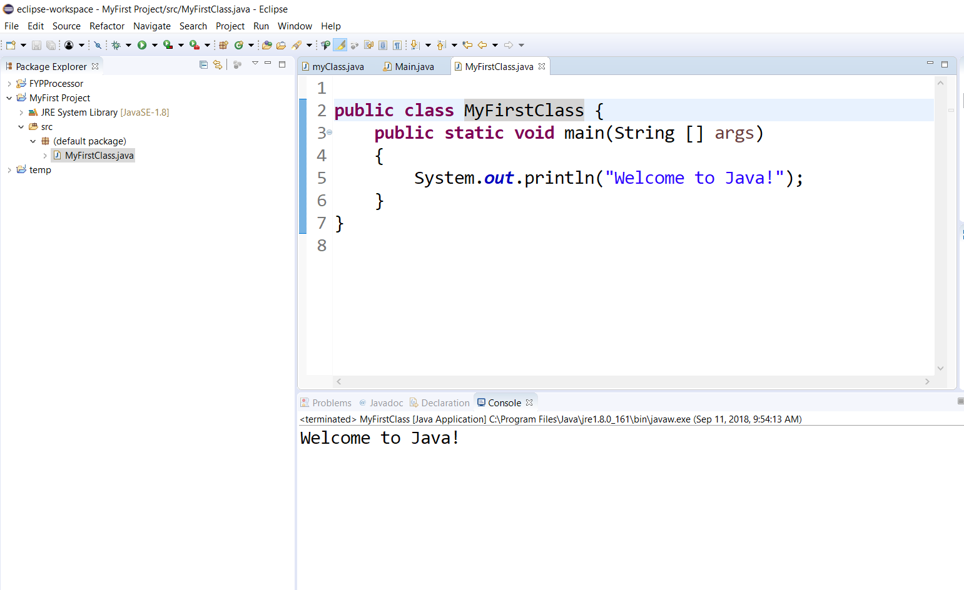
© Copyright 1992-2012 by Pearson Education, Inc. All Rights Reserved.

Slide 22
Compiling and Executing Your First Java Application
  Open a command window and change to the directory where the program is stored.
  Many operating systems use the command cd to change directories.
  To compile the program, type
    javac Welcome1.java
  If the program contains no syntax errors, preceding command creates a.class file (known as the class file) containing the platform-independent Java bytecodes that represent the application.
  When we use the java command to execute the application on a given platform, these bytecodes will be translated by the JVM into instructions that are understood by the underlying operating system.
© Copyright 1992-2012 by Pearson Education, Inc. All Rights Reserved.

Slide 23
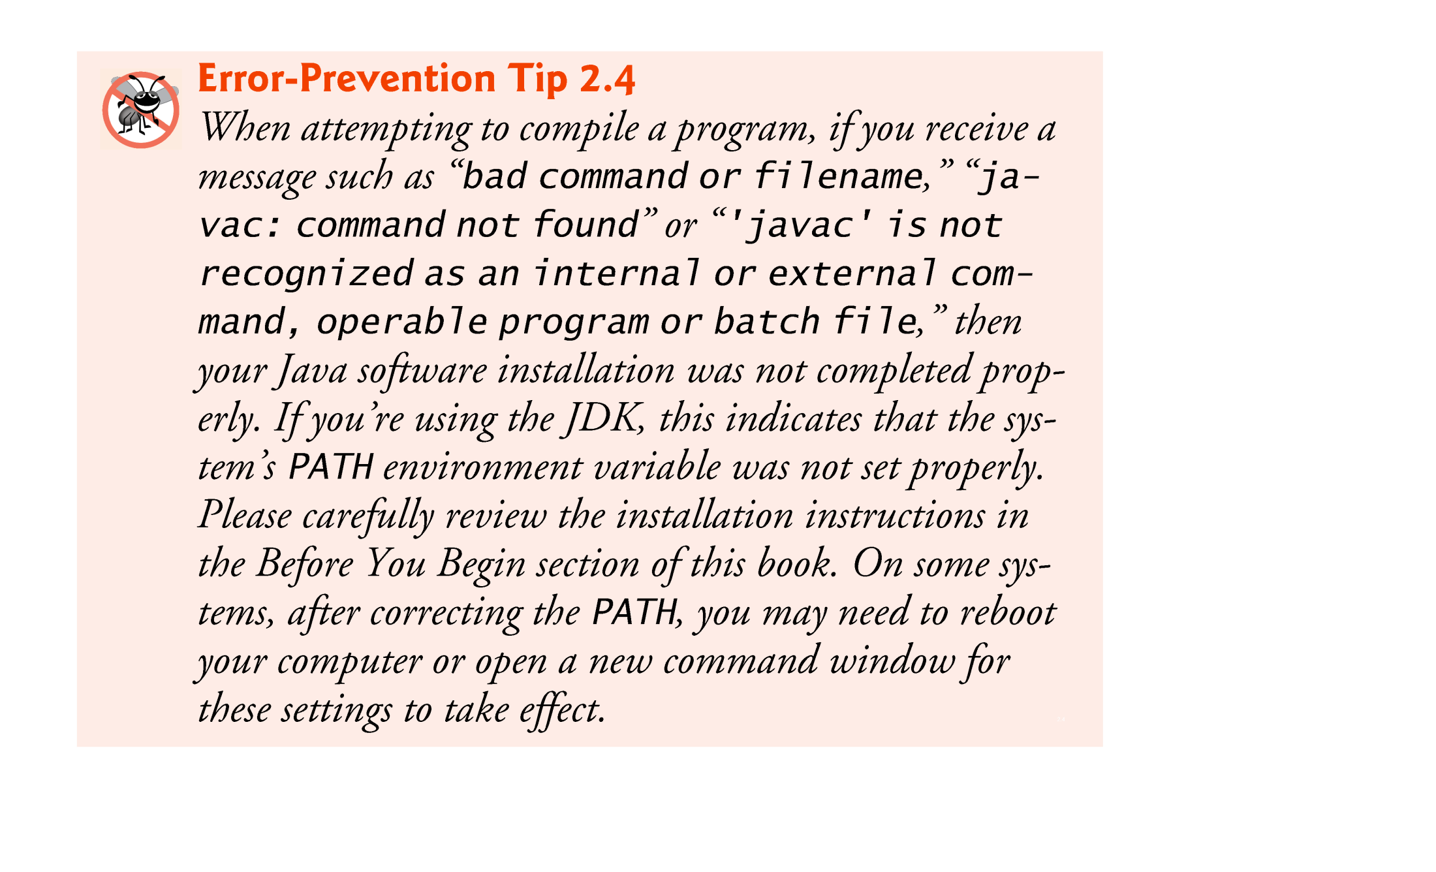
© Copyright 1992-2012 by Pearson Education, Inc. All Rights Reserved.

Slide 24
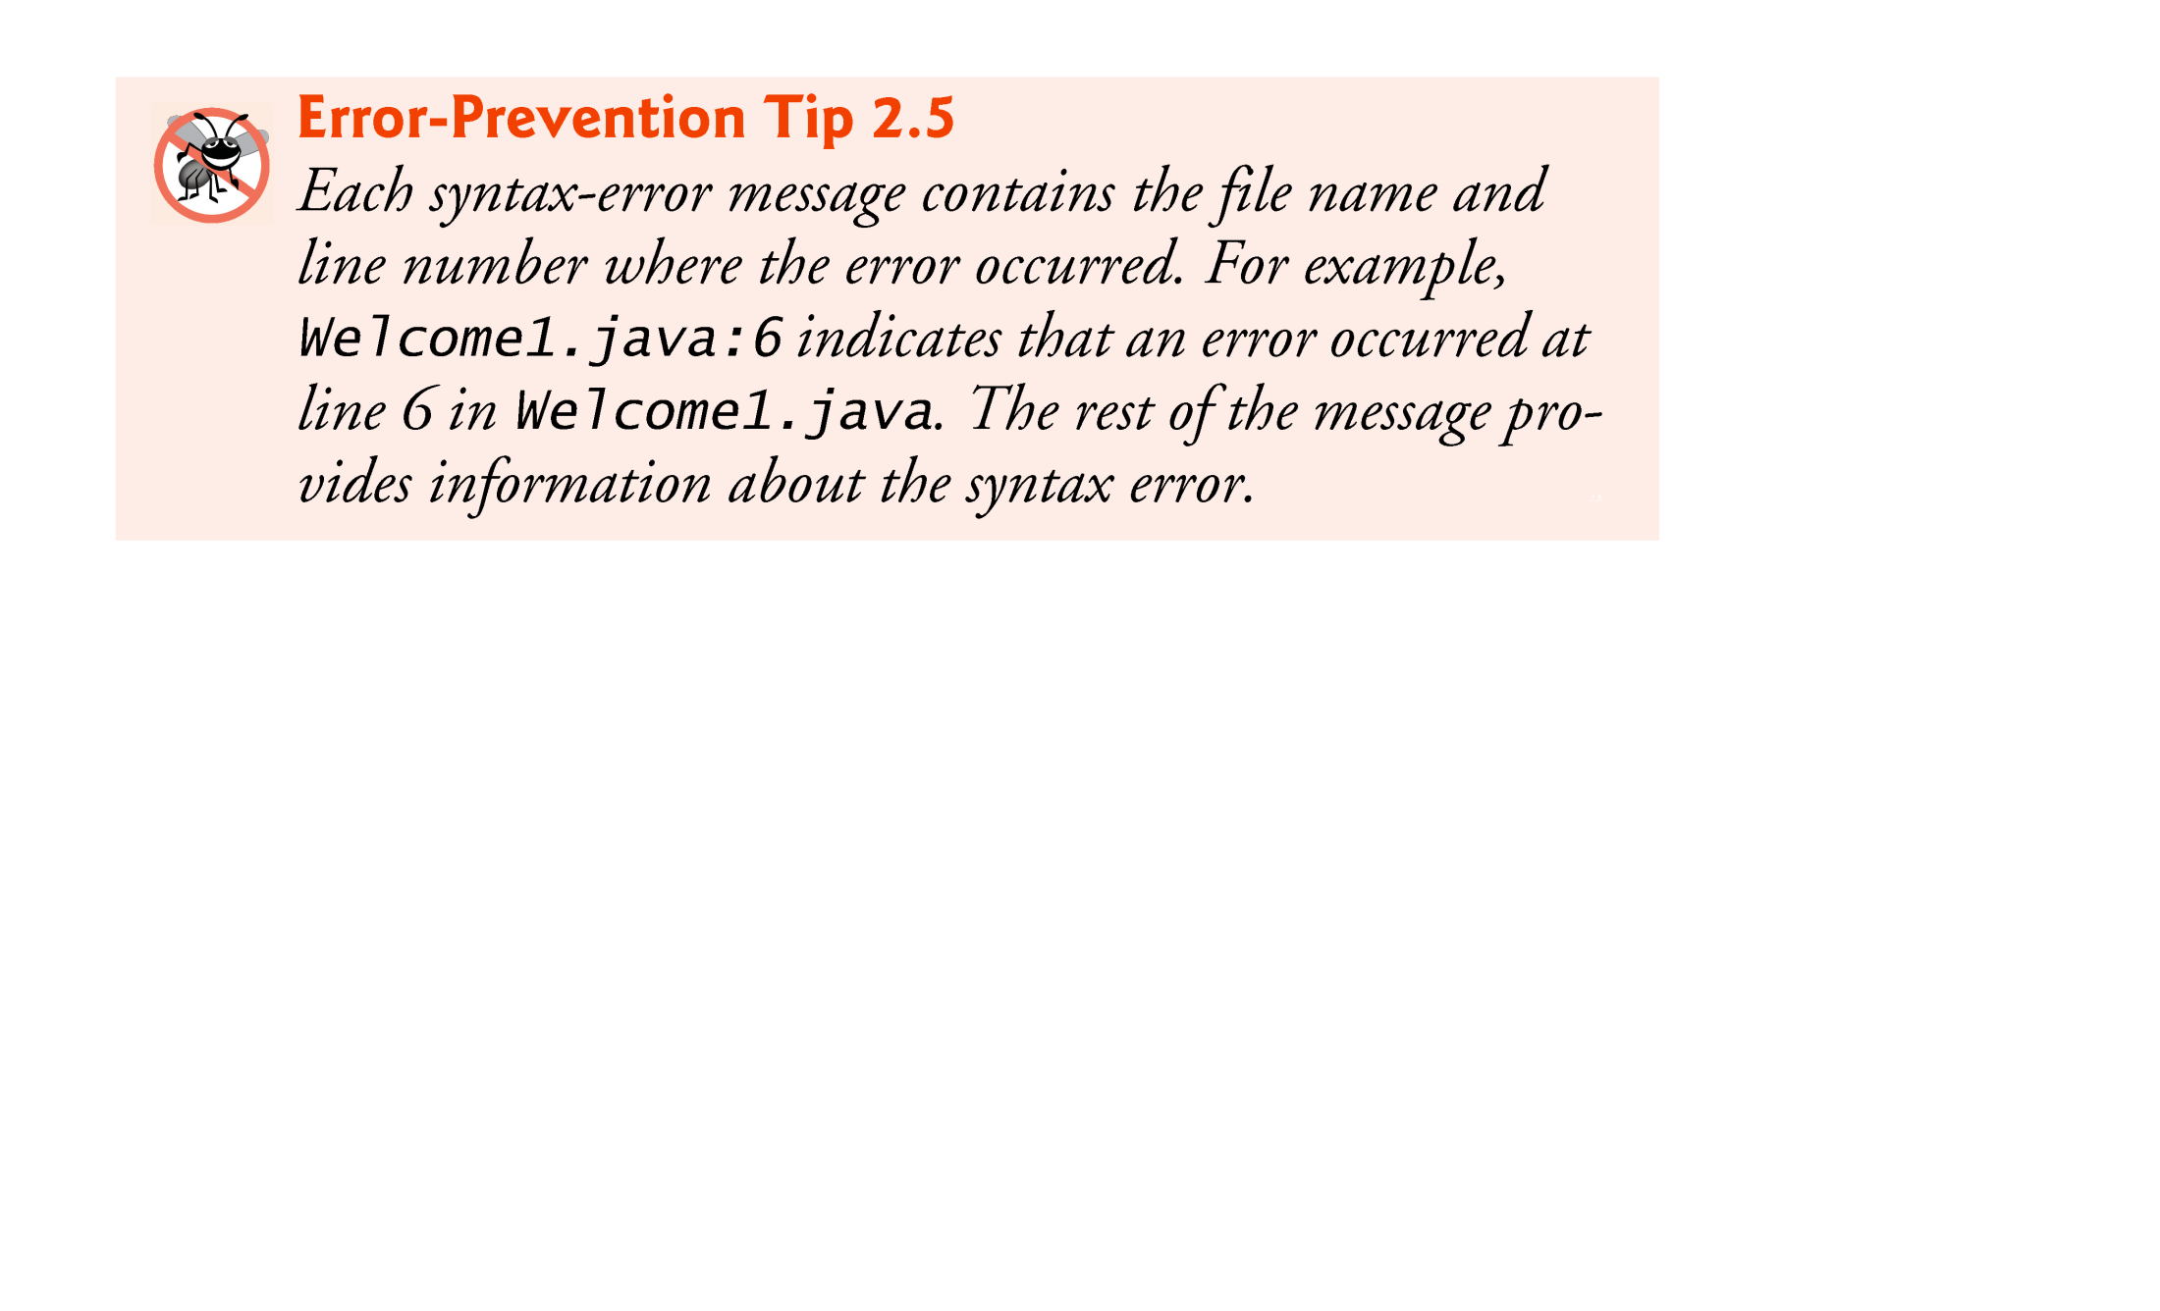
© Copyright 1992-2012 by Pearson Education, Inc. All Rights Reserved.

Slide 25
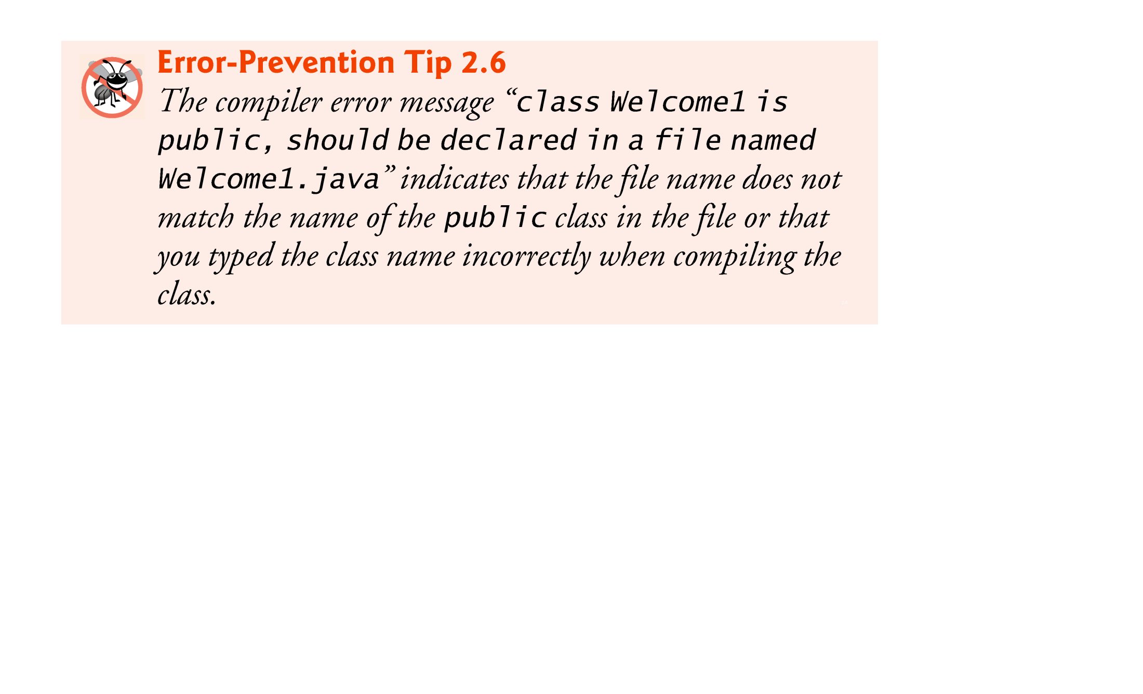
© Copyright 1992-2012 by Pearson Education, Inc. All Rights Reserved.

Slide 26
To execute the program, type java Welcome1.
Launches the JVM, which loads the .class file for class Welcome1.
Note that the .class file-name extension is omitted from the preceding command; otherwise, the JVM will not execute the program.
The JVM calls method main to execute the program.
© Copyright 1992-2012 by Pearson Education, Inc. All Rights Reserved.

Slide 27
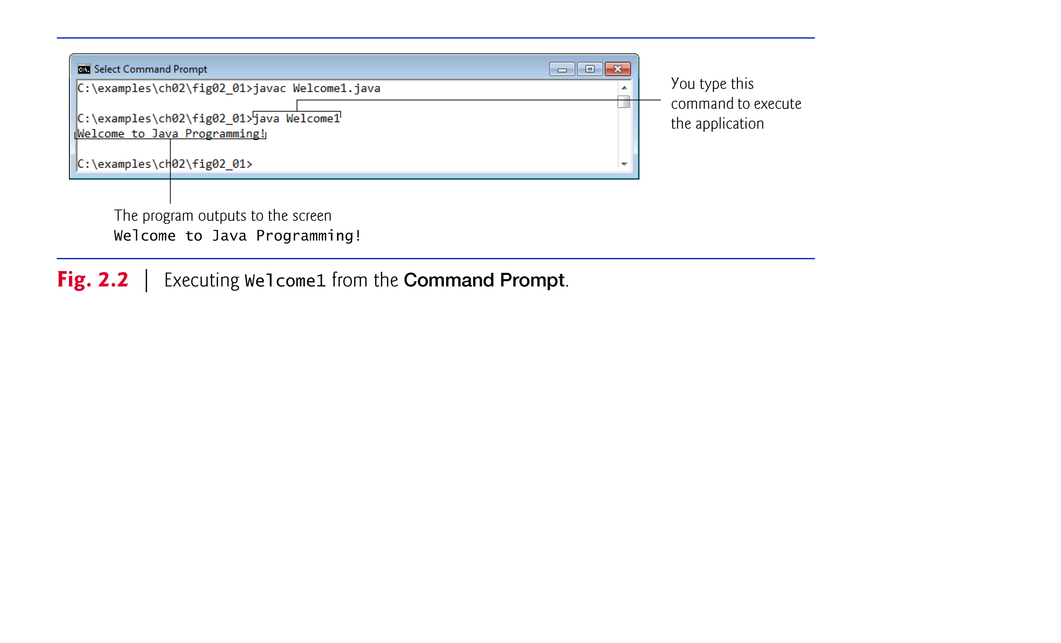
© Copyright 1992-2012 by Pearson Education, Inc. All Rights Reserved.

Slide 28

Class Welcome2, shown in Fig. 2.3, uses two statements to produce the same output as that shown in Fig. 2.1.
New and key features in each code listing are highlighted.
System.out’s method print displays a string.
Unlike println, print does not position the output cursor at the beginning of the next line in the command window.
  The next character the program displays will appear immediately after the last character that print displays.
© Copyright 1992-2012 by Pearson Education, Inc. All Rights Reserved.

Slide 29
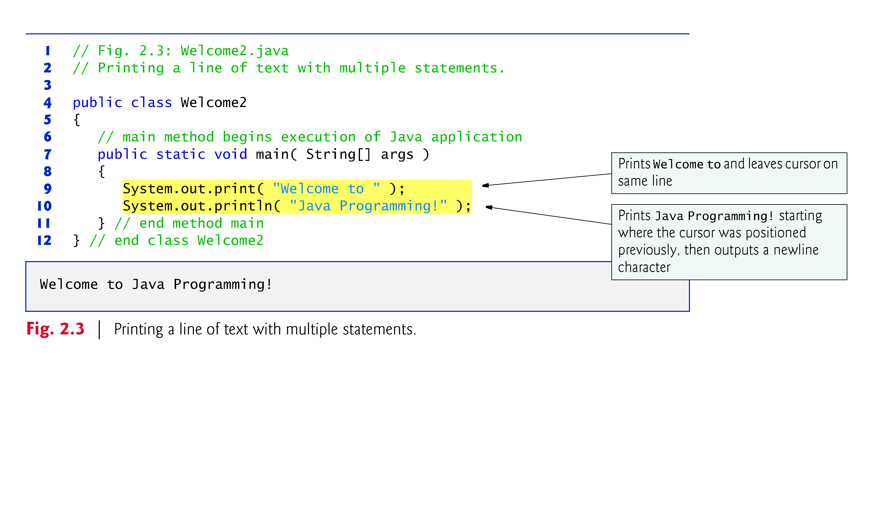
© Copyright 1992-2012 by Pearson Education, Inc. All Rights Reserved.

Slide 30
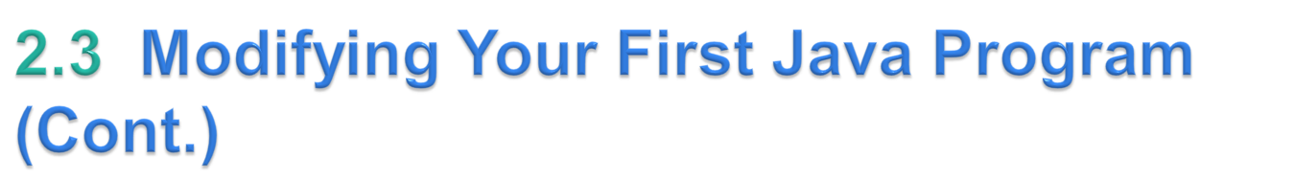
Newline characters are white-space characters.
The backslash (\) is called an escape character.
  Indicates a “special character”
Backslash is combined with the next character to form an escape sequence.
The escape sequence \n represents the newline character.
© Copyright 1992-2012 by Pearson Education, Inc. All Rights Reserved.

Slide 31
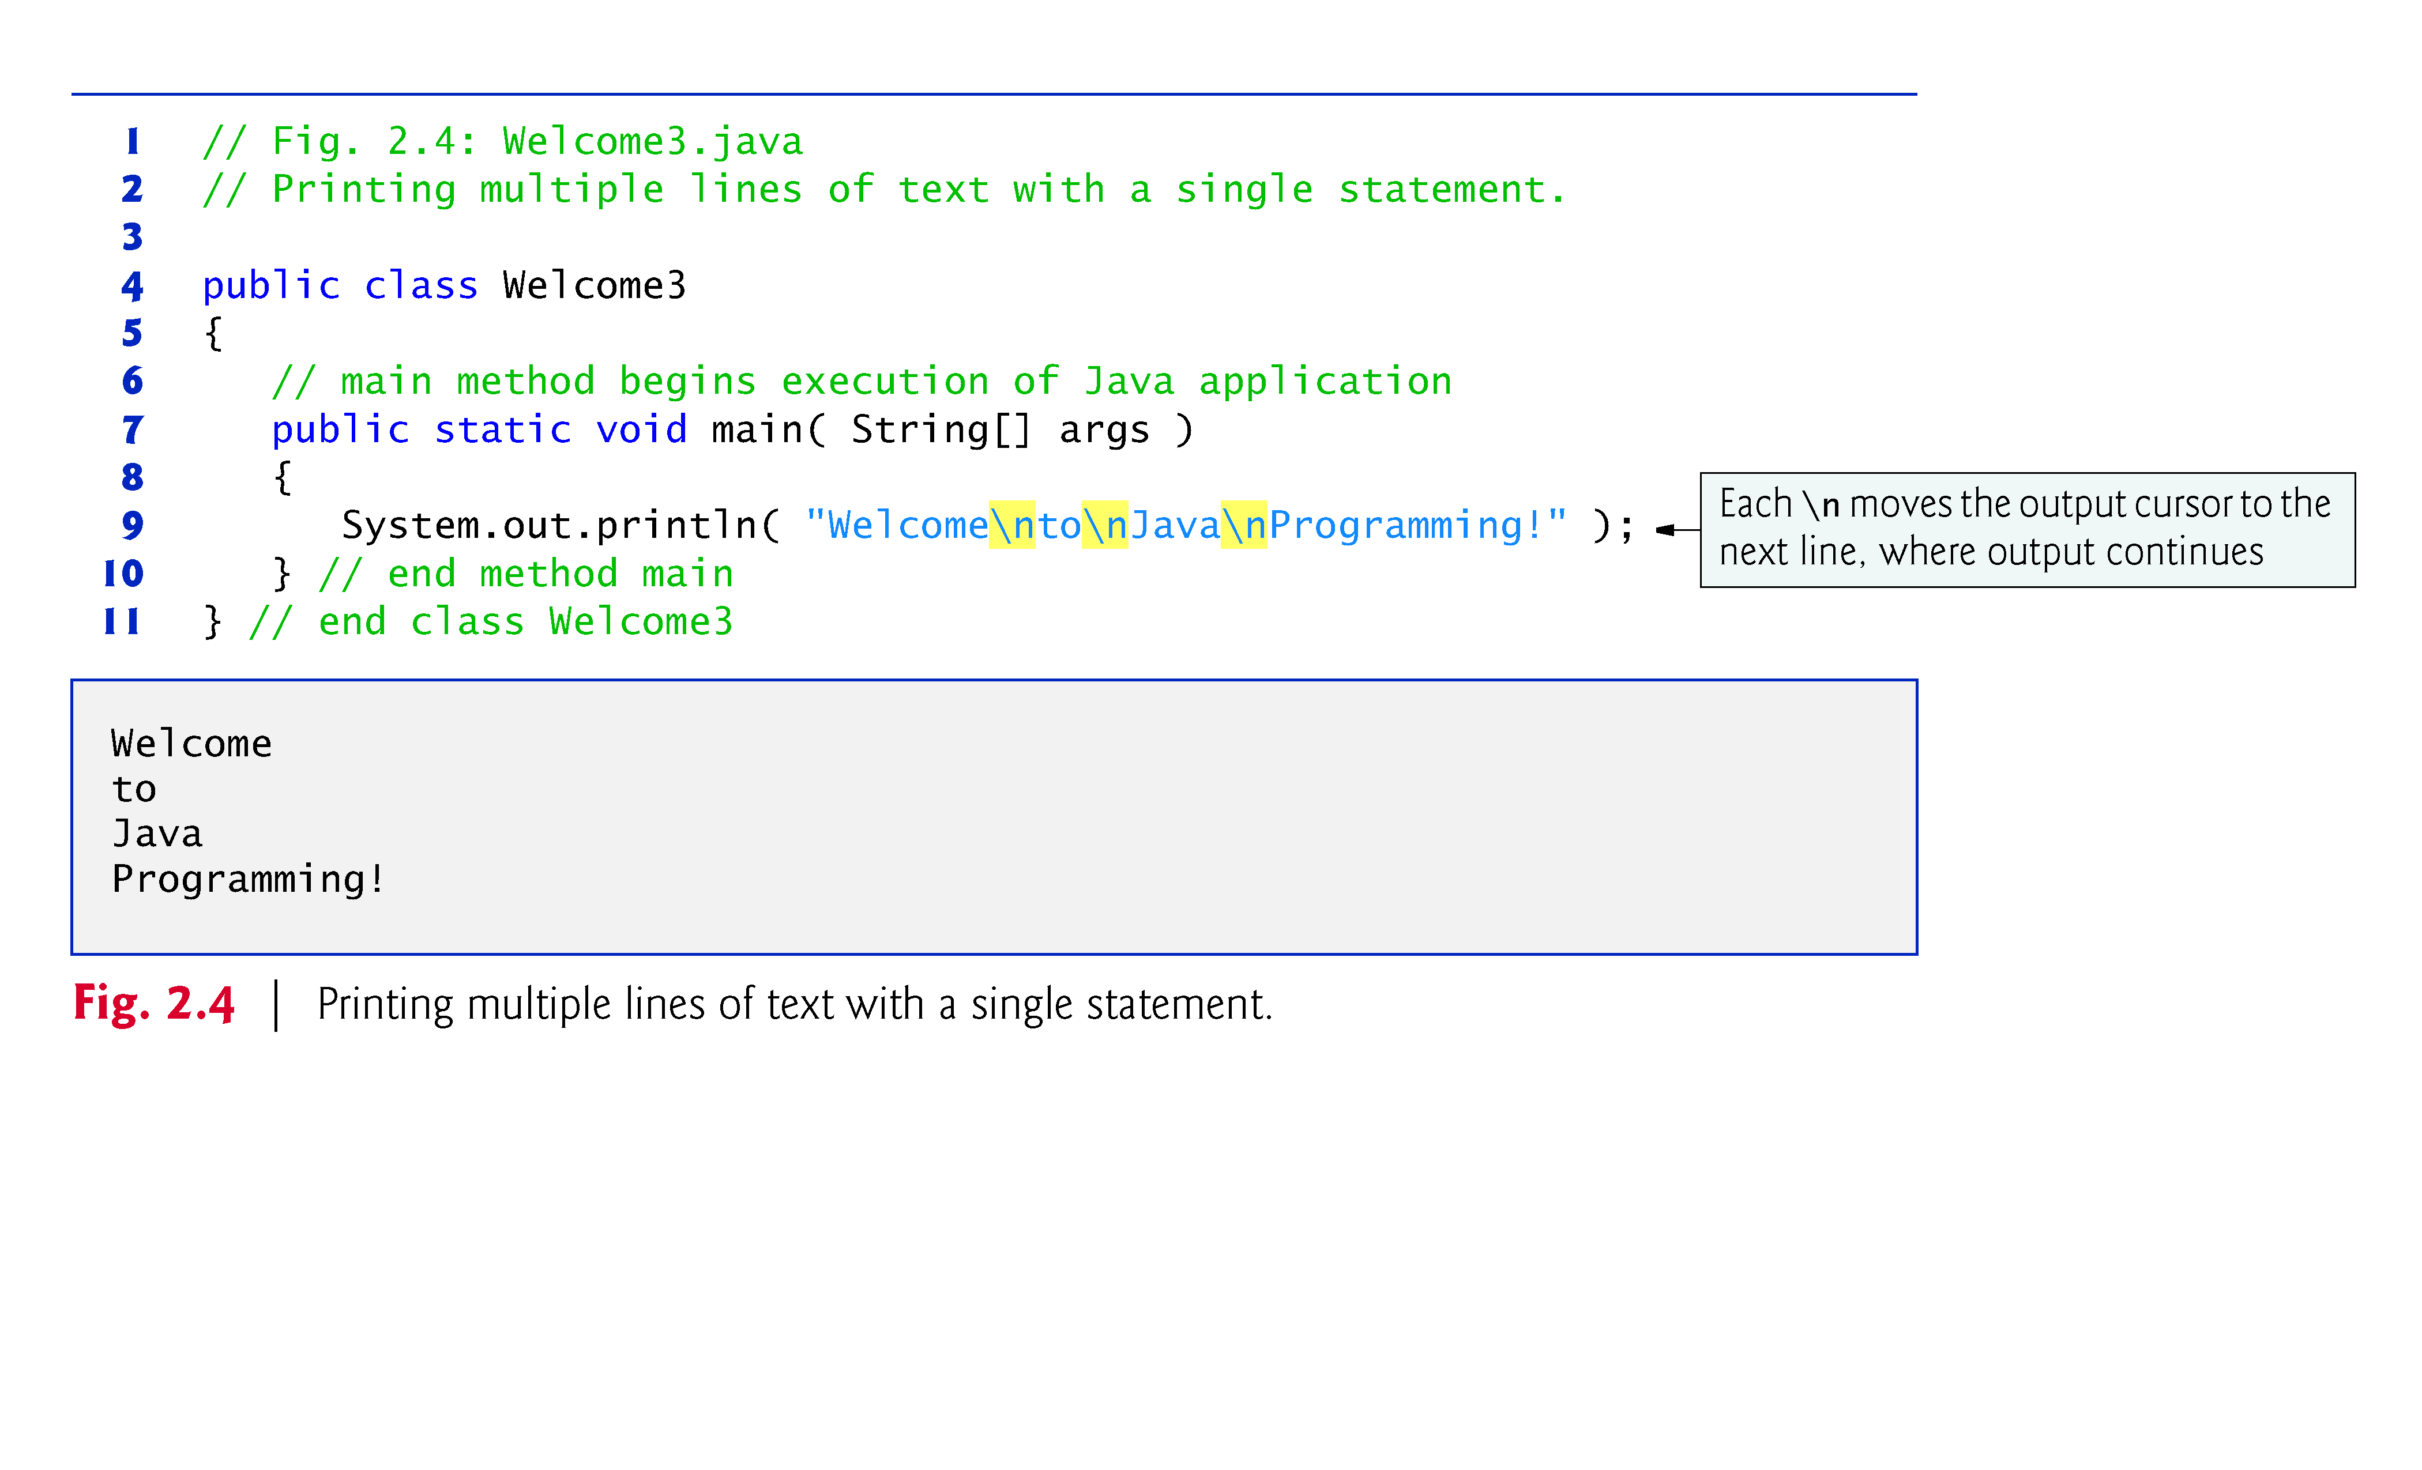
© Copyright 1992-2012 by Pearson Education, Inc. All Rights Reserved.

Slide 32
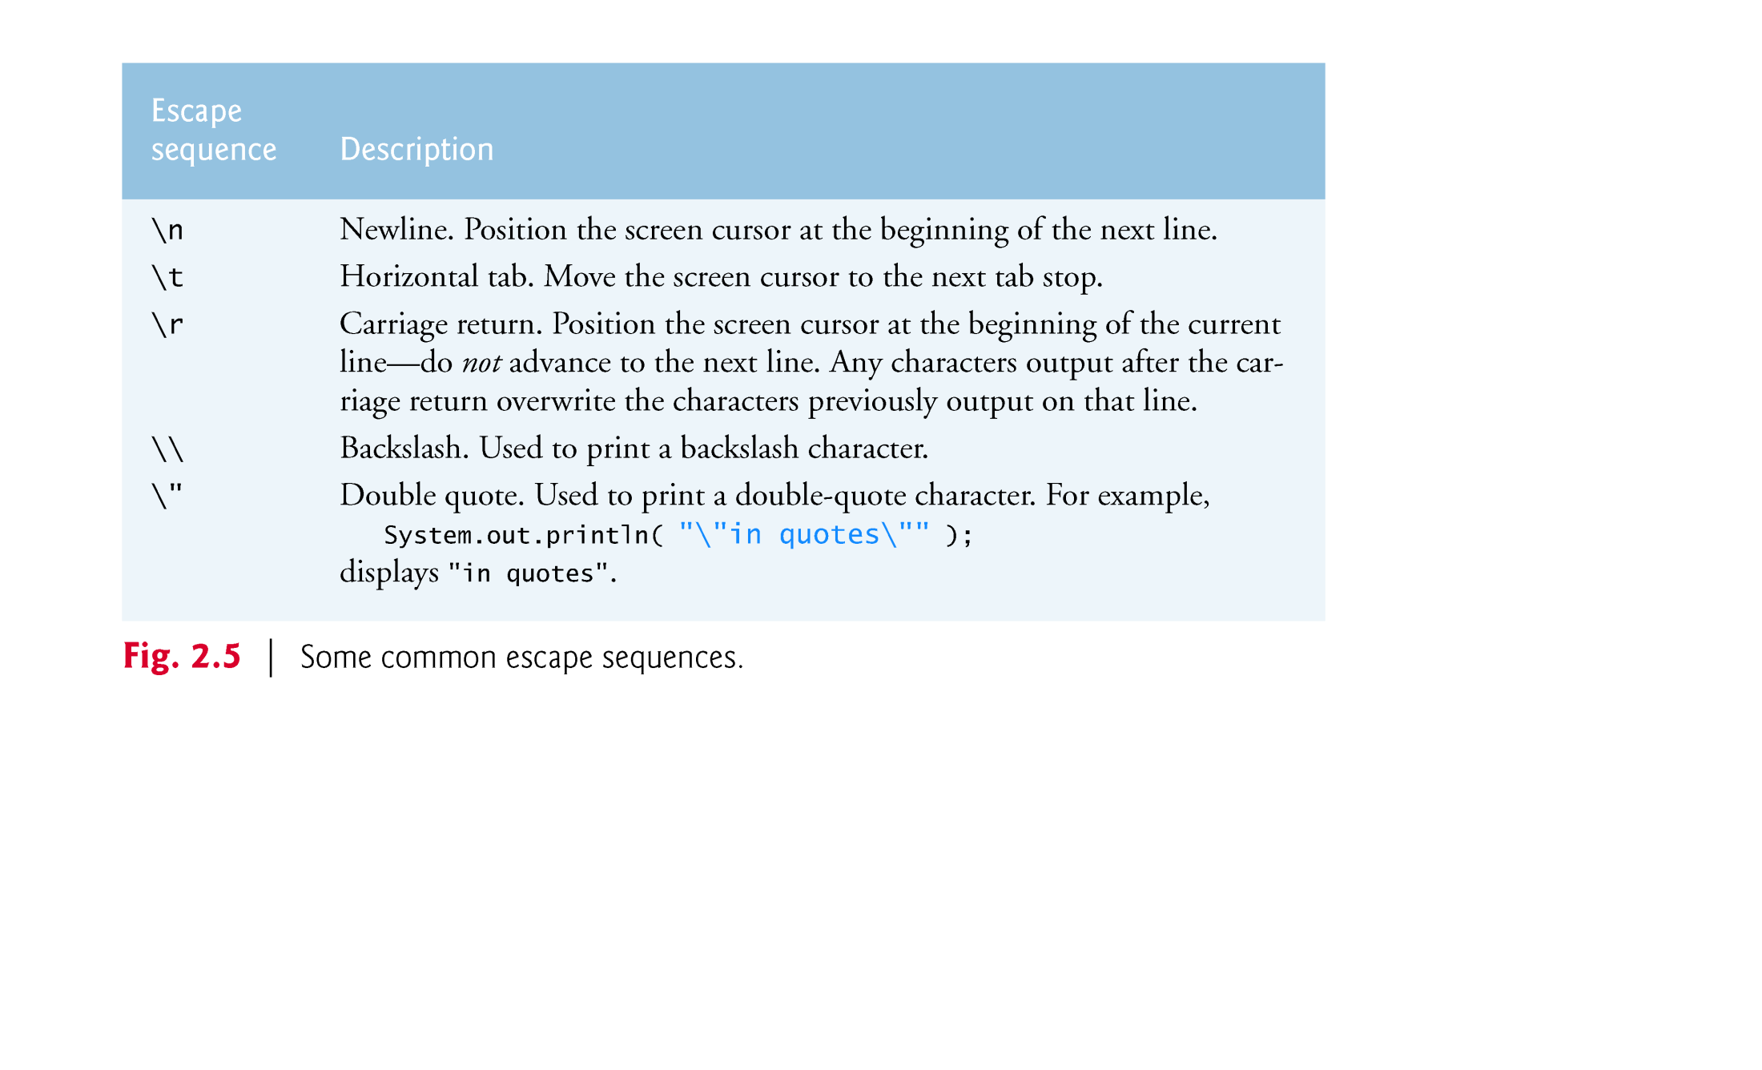
© Copyright 1992-2012 by Pearson Education, Inc. All Rights Reserved.

Slide 33

System.out.printf method
  f means “formatted”
  displays formatted data
Multiple method arguments are placed in a comma-separated list.
Java allows large statements to be split over many lines.
  Cannot split a statement in the middle of an identifier or string.
© Copyright 1992-2012 by Pearson Education, Inc. All Rights Reserved.

Slide 34
Method printf’s first argument is a format string
  May consist of fixed text and format specifiers.
  Fixed text is output as it would be by print or println.
  Each format specifier is a placeholder for a value and specifies the type of data to output.
Format specifiers begin with a percent sign (%) and are followed by a character that represents the data type.
Format specifier %s is a placeholder for a string.
© Copyright 1992-2012 by Pearson Education, Inc. All Rights Reserved.

Slide 35
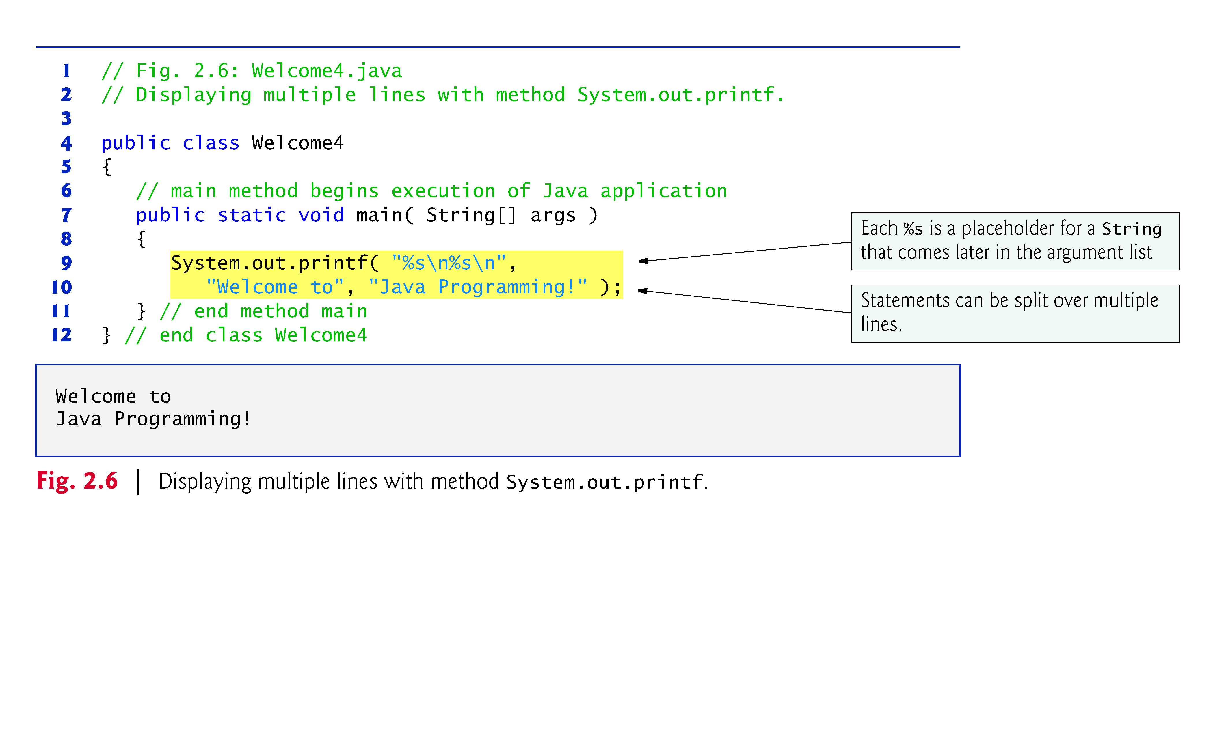
© Copyright 1992-2012 by Pearson Education, Inc. All Rights Reserved.

Slide 36

© Copyright 1992-2012 by Pearson Education, Inc. All Rights Reserved.

Slide 37
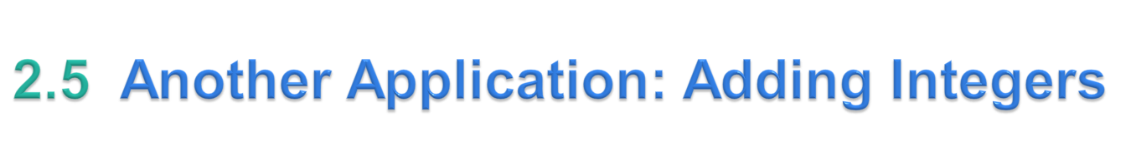
Integers
  Whole numbers, like –22, 7, 0 and 1024
Programs remember numbers and other data in the computer’s memory and access that data through program elements called variables.
The program of Fig. 2.7 demonstrates these concepts.
© Copyright 1992-2012 by Pearson Education, Inc. All Rights Reserved.

Slide 38
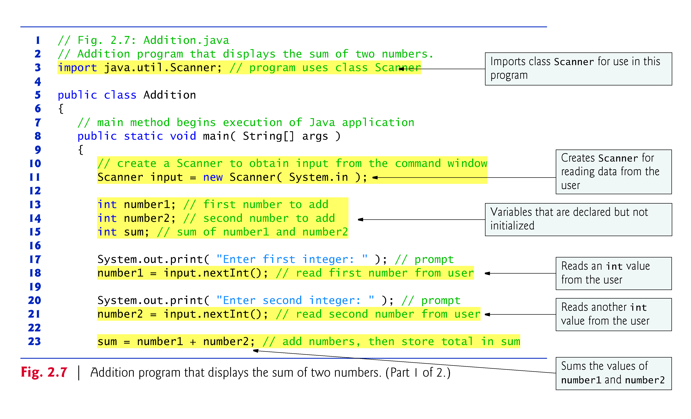
© Copyright 1992-2012 by Pearson Education, Inc. All Rights Reserved.

Slide 39
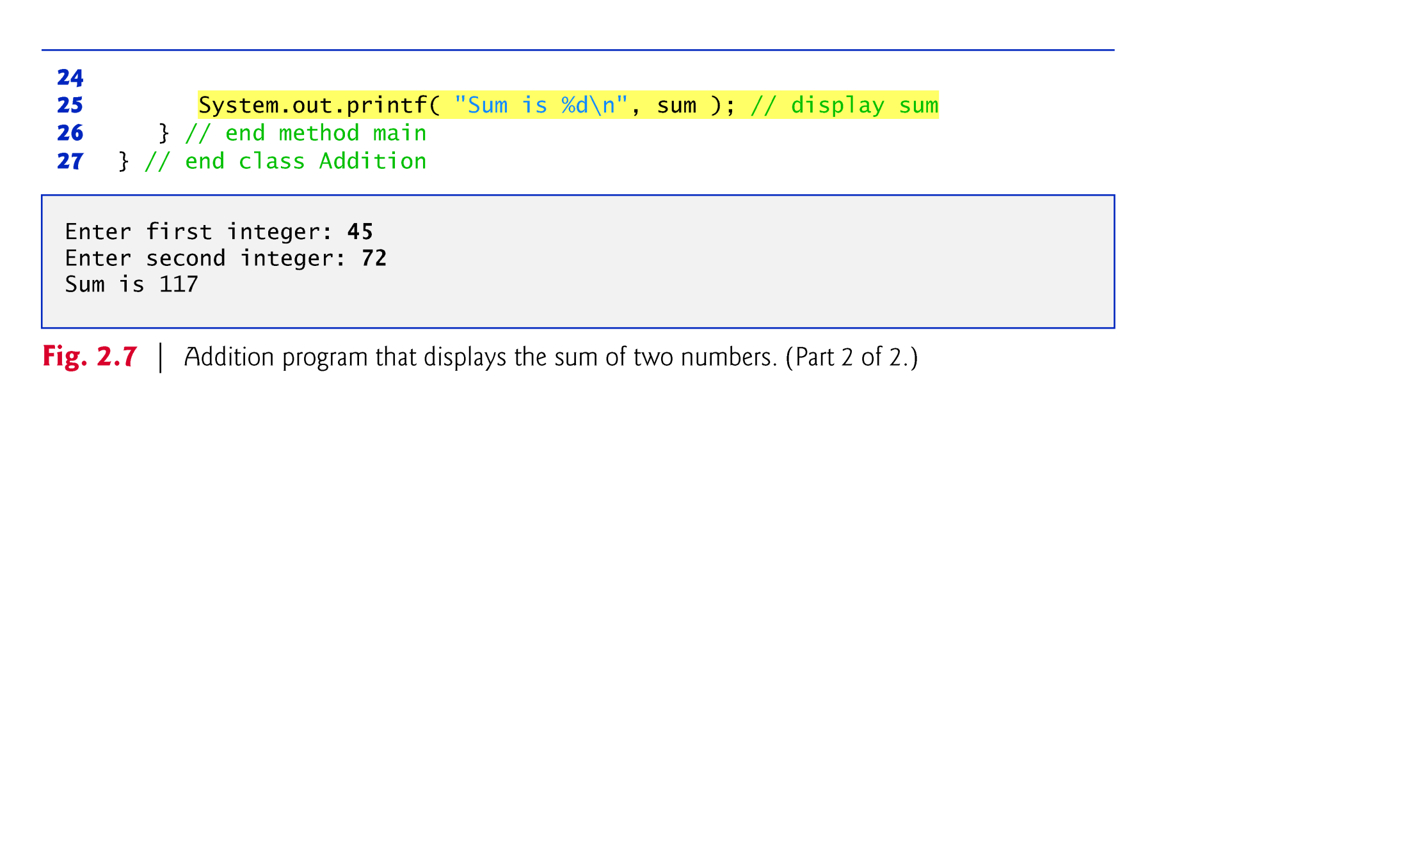
© Copyright 1992-2012 by Pearson Education, Inc. All Rights Reserved.

Slide 40
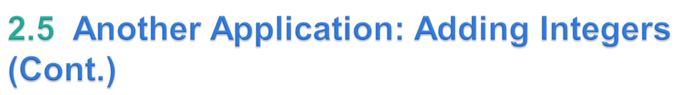
import declaration
  Helps the compiler locate a class that is used in this program.
  Rich set of predefined classes that you can reuse rather than “reinventing the wheel.”
  Classes are grouped into packages—named groups of related classes—and are collectively referred to as the Java class library, or the Java Application Programming Interface (Java API).
  You use import declarations to identify the predefined classes used in a Java program.
© Copyright 1992-2012 by Pearson Education, Inc. All Rights Reserved.

Slide 41
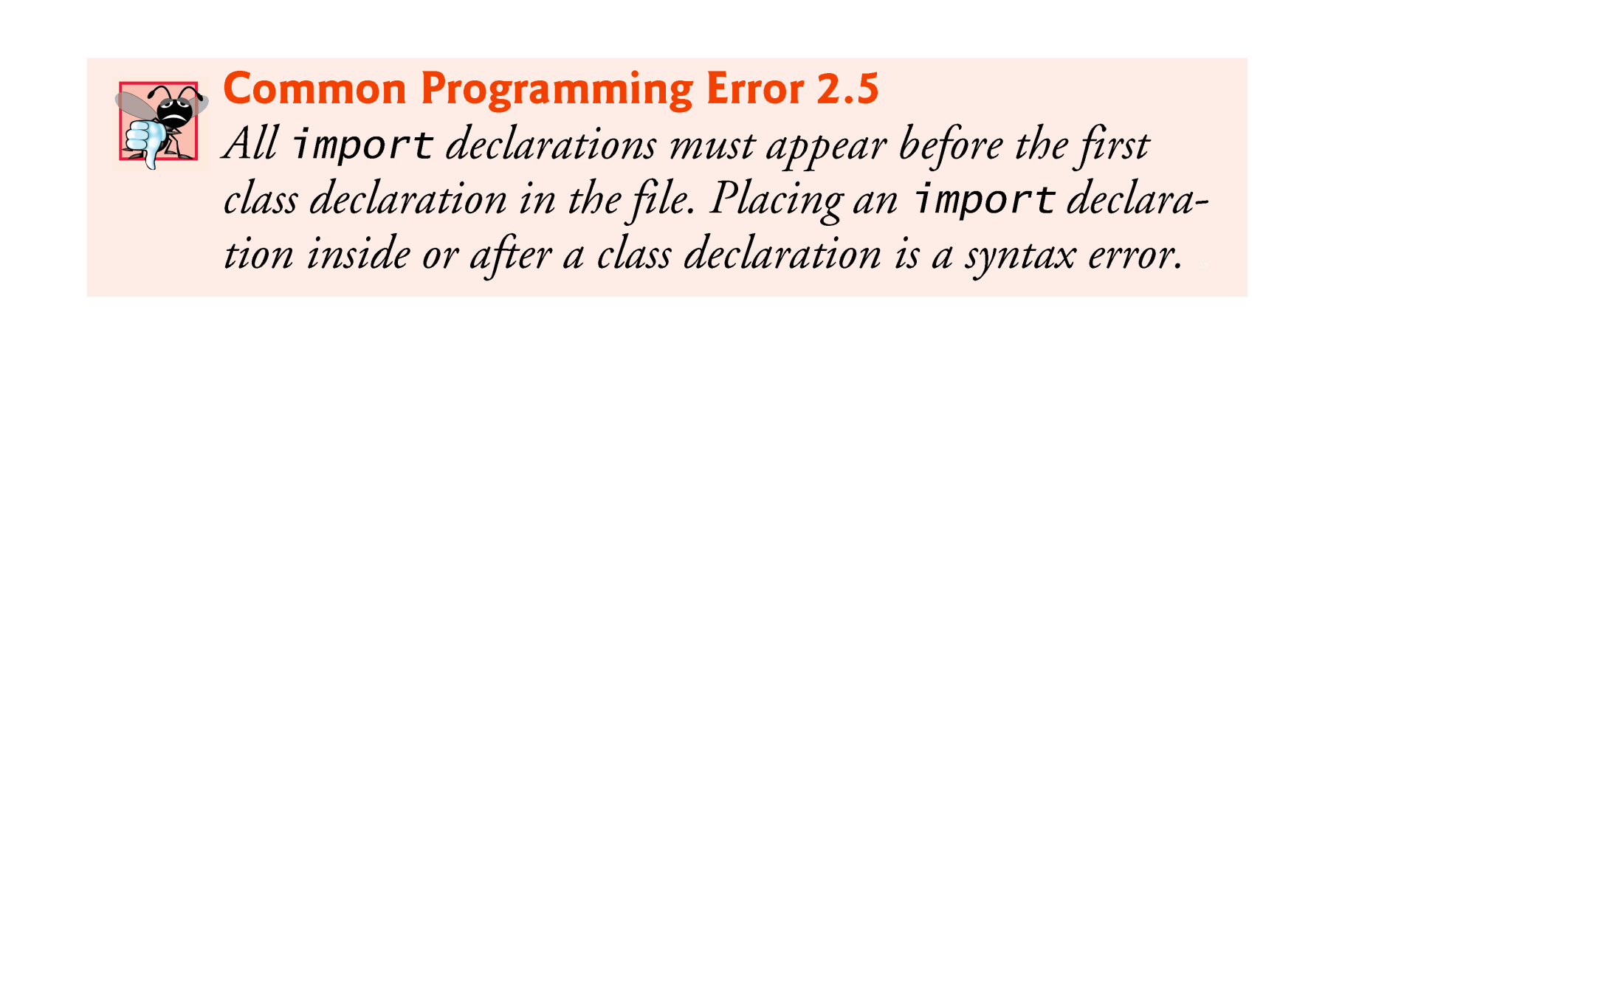
© Copyright 1992-2012 by Pearson Education, Inc. All Rights Reserved.

Slide 42
Variable declaration statement
    Scanner input = new Scanner( System.in );
  Specifies the name (input) and type (Scanner) of a variable that is used in this program.
Variable
  A location in the computer’s memory where a value can be stored for use later in a program.
  Must be declared with a name and a type before they can be used.
  A variable’s name enables the program to access the value of the variable in memory.
  The name can be any valid identifier.
  A variable’s type specifies what kind of information is stored at that location in memory.
© Copyright 1992-2012 by Pearson Education, Inc. All Rights Reserved.

Slide 43
Scanner
  Enables a program to read data for use in a program.
  Data can come from many sources, such as the user at the keyboard or a file on disk.
  Before using a Scanner, you must create it and specify the source of the data.
The equals sign (=) in a declaration indicates that the variable should be initialized (i.e., prepared for use in the program) with the result of the expression to the right of the equals sign.
The new keyword creates an object.
Standard input object, System.in, enables applications to read bytes of information typed by the user.
Scanner object translates these bytes into types that can be used in a program.
© Copyright 1992-2012 by Pearson Education, Inc. All Rights Reserved.

Slide 44
Variable declaration statements
    int number1; // first number to add
    int number2; // second number to add
    int sum; // sum of number1 and number2
declare that variables number1, number2 and sum hold data of type int
  They can hold integer.
  Range of values for an int is –2,147,483,648 to +2,147,483,647.
  Actual int values do not contain commas.
Several variables of the same type may be declared in one declaration with the variable names separated by commas.
© Copyright 1992-2012 by Pearson Education, Inc. All Rights Reserved.

Slide 45
Prompt
  Output statement that directs the user to take a specific action.
System is a class.
  Part of package java.lang.
  Class System is not imported with an import declaration at the beginning of the program.
© Copyright 1992-2012 by Pearson Education, Inc. All Rights Reserved.

Slide 46
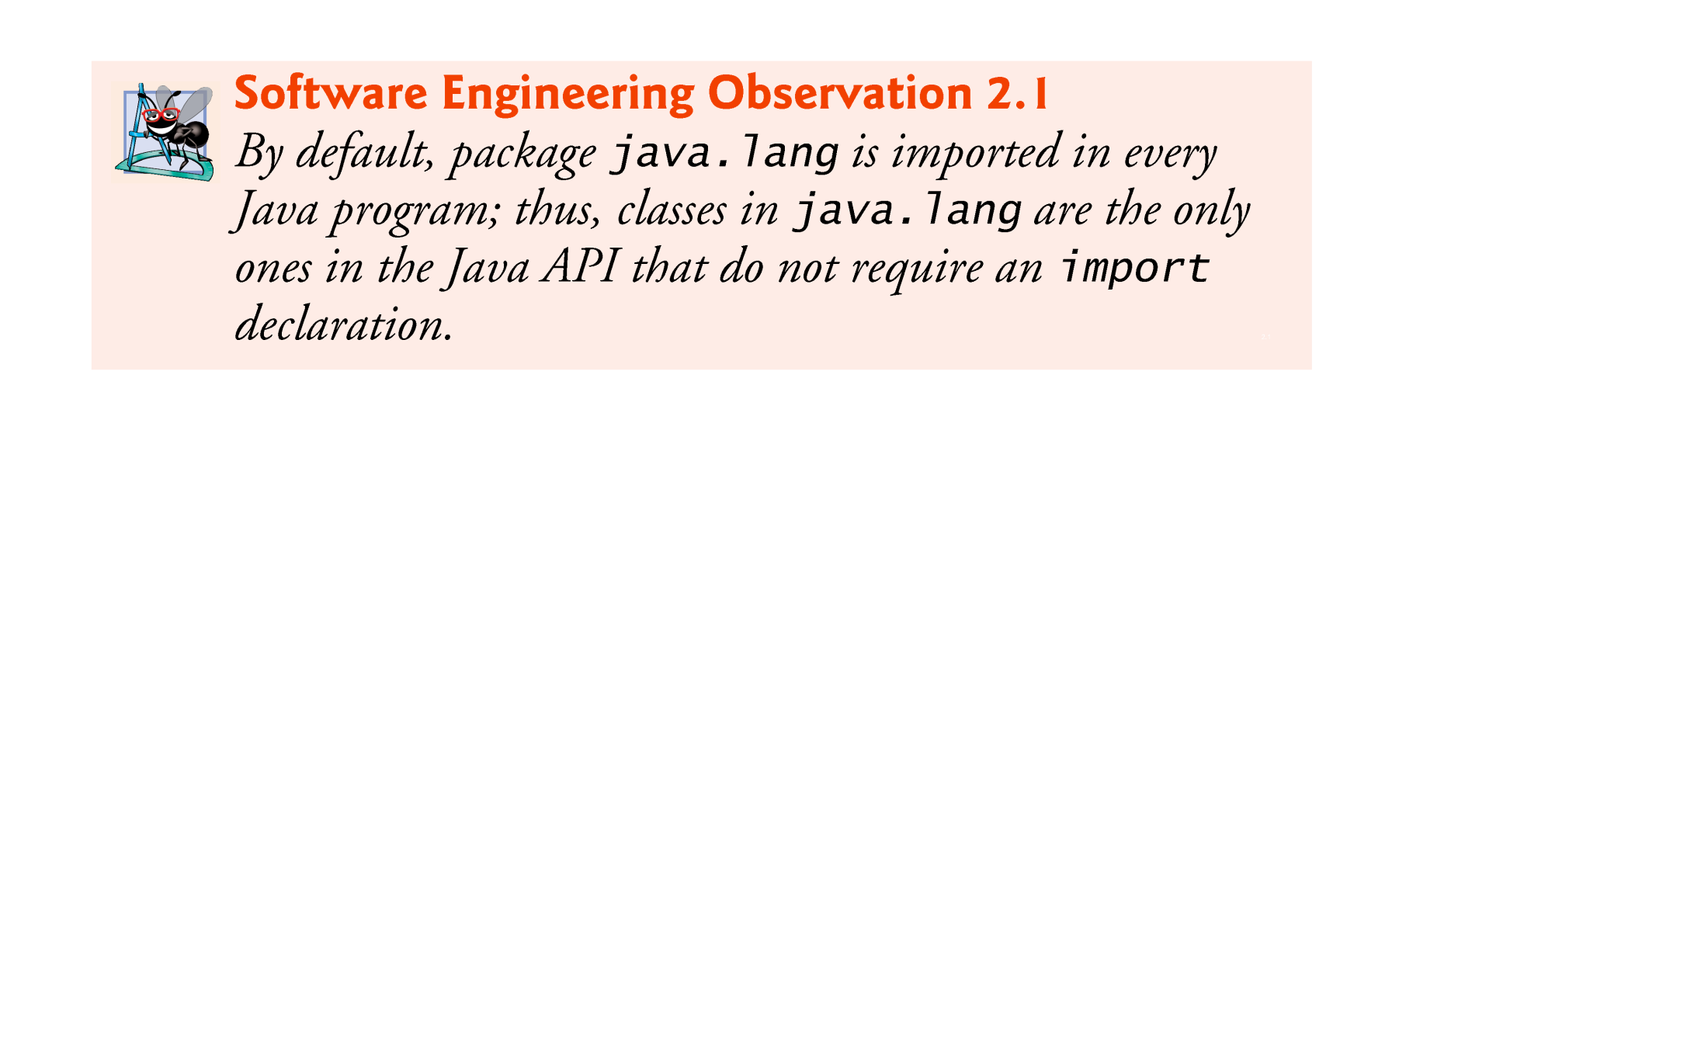
© Copyright 1992-2012 by Pearson Education, Inc. All Rights Reserved.

Slide 47
Scanner method nextInt
    number1 = input.nextInt(); // read first number from user
  Obtains an integer from the user at the keyboard.
  Program waits for the user to type the number and press the Enter key to submit the number to the program.
The result of the call to method nextInt is placed in variable number1 by using the assignment operator, =.
  “number1 gets the value of input.nextInt().”
  Operator = is called a binary operator—it has two operands.
  Everything to the right of the assignment operator, =, is always evaluated before the assignment is performed.
© Copyright 1992-2012 by Pearson Education, Inc. All Rights Reserved.

Slide 48
Arithmetic
    sum = number1 + number2; // add numbers
  Assignment statement that calculates the sum of the variables number1 and number2 then assigns the result to variable sum by using the assignment operator, =.
  “sum gets the value of number1 + number2.”
  In general, calculations are performed in assignment statements.
  Portions of statements that contain calculations are called expressions.
© Copyright 1992-2012 by Pearson Education, Inc. All Rights Reserved.

Slide 49
Integer formatted output
    System.out.printf( "Sum is %d\n", sum );
  Format specifier %d is a placeholder for an int value
  The letter d stands for “decimal integer.”
© Copyright 1992-2012 by Pearson Education, Inc. All Rights Reserved.

Slide 50

Variables
  Every variable has a name, a type, a size (in bytes) and a value.
  When a new value is placed into a variable, the new value replaces the previous value (if any)
  The previous value is lost.
© Copyright 1992-2012 by Pearson Education, Inc. All Rights Reserved.

Slide 51
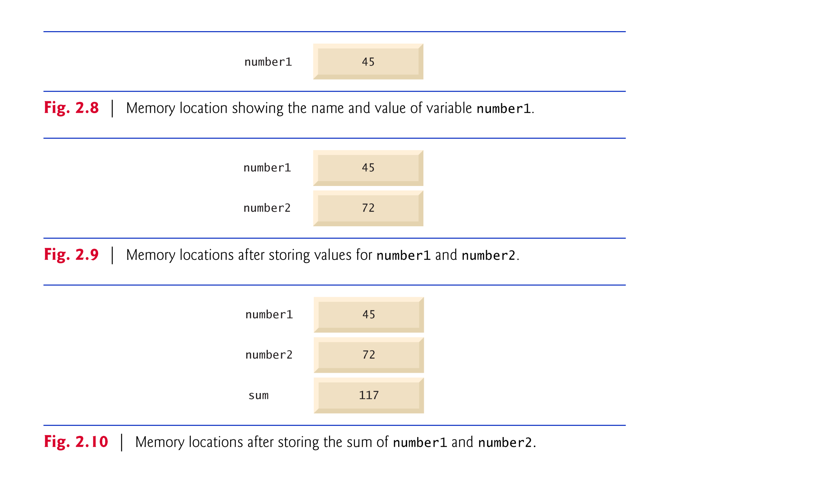
© Copyright 1992-2012 by Pearson Education, Inc. All Rights Reserved.

Slide 52

Arithmetic operators are summarized in Fig. 2.11.
The asterisk (*) indicates multiplication
The percent sign (%) is the remainder operator
The arithmetic operators are binary operators because they each operate on two operands.
Integer division yields an integer quotient.
  Any fractional part in integer division is simply discarded (i.e., truncated)—no rounding occurs.
The remainder operator, %, yields the remainder after division.
© Copyright 1992-2012 by Pearson Education, Inc. All Rights Reserved.

Slide 53
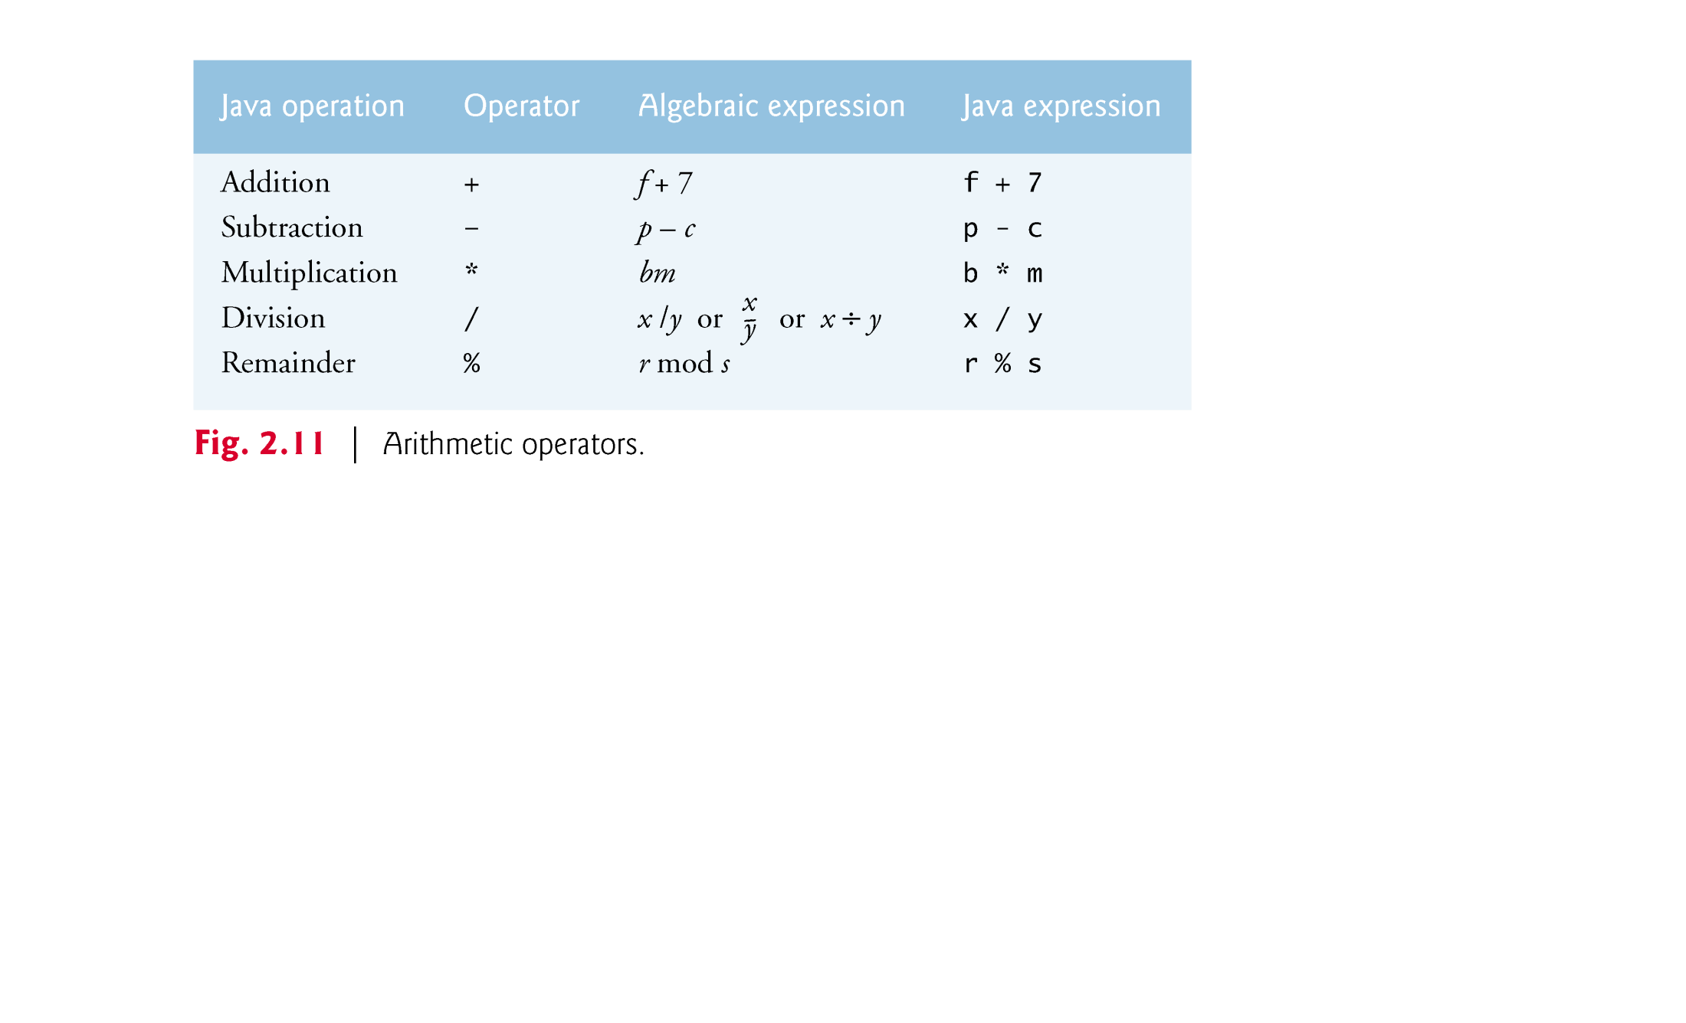
© Copyright 1992-2012 by Pearson Education, Inc. All Rights Reserved.

Slide 54

Arithmetic expressions in Java must be written in straight-line form to facilitate entering programs into the computer.
Expressions such as “a divided by b” must be written as a / b, so that all constants, variables and operators appear in a straight line.
Parentheses are used to group terms in expressions in the same manner as in algebraic expressions.
If an expression contains nested parentheses, the expression in the innermost set of parentheses is evaluated first.
© Copyright 1992-2012 by Pearson Education, Inc. All Rights Reserved.

Slide 55
Rules of operator precedence
  Multiplication, division and remainder operations are applied first.
  If an expression contains several such operations, they are applied from left to right.
  Multiplication, division and remainder operators have the same level of precedence.
  Addition and subtraction operations are applied next.
  If an expression contains several such operations, the operators are applied from left to right.
  Addition and subtraction operators have the same level of precedence.
When we say that operators are applied from left to right, we are referring to their associativity.
Some operators associate from right to left like the assignment operator.
© Copyright 1992-2012 by Pearson Education, Inc. All Rights Reserved.

Slide 56
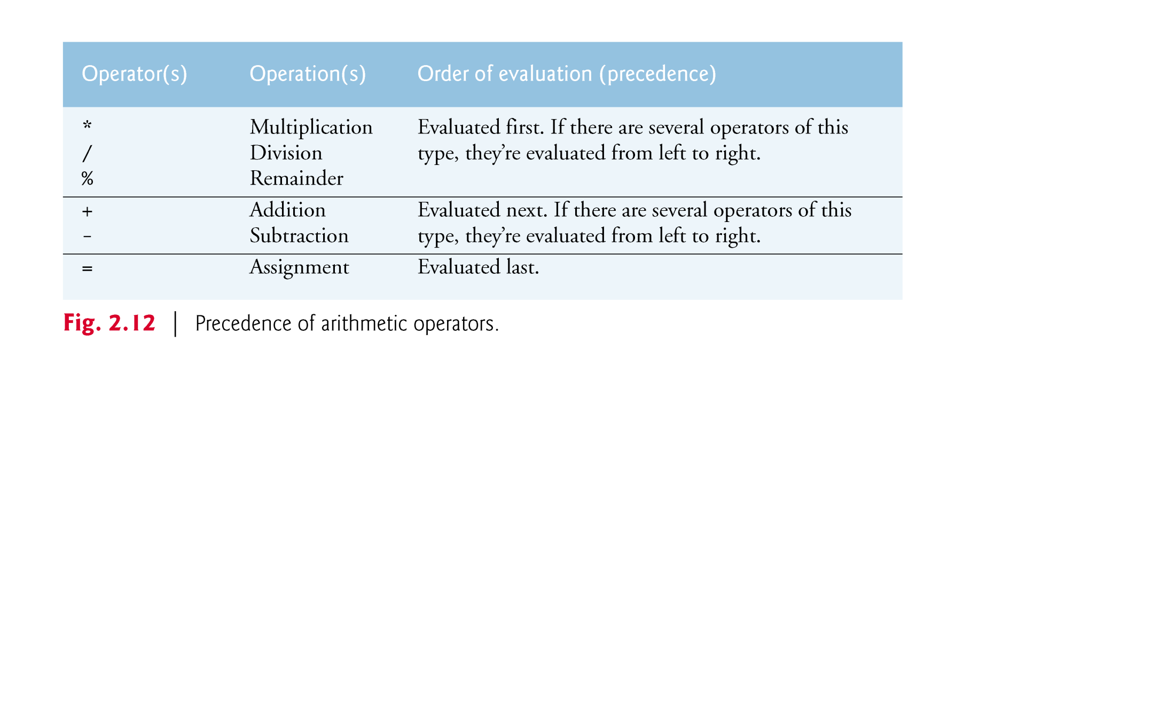
© Copyright 1992-2012 by Pearson Education, Inc. All Rights Reserved.

Slide 57
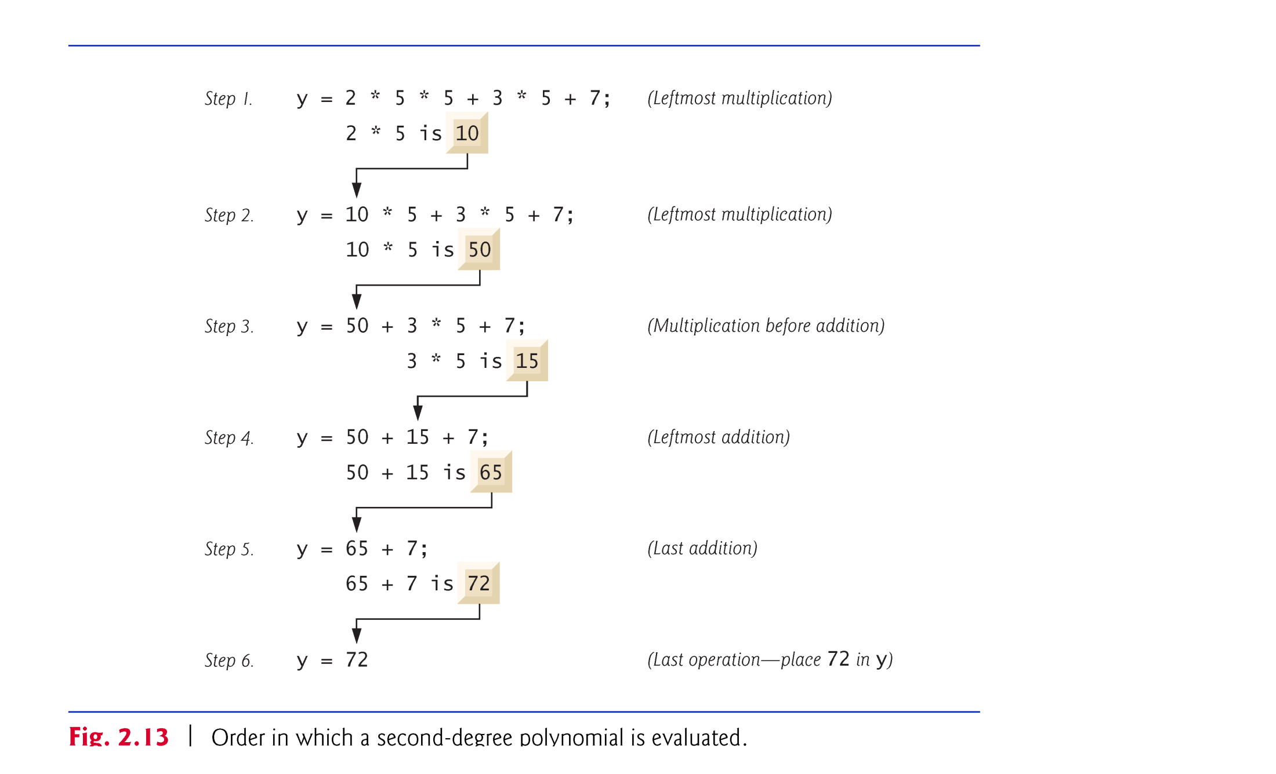
© Copyright 1992-2012 by Pearson Education, Inc. All Rights Reserved.

Slide 58
As in algebra, it’s acceptable to place redundant parentheses (unnecessary parentheses) in an ex-pression to make the expression clearer.
© Copyright 1992-2012 by Pearson Education, Inc. All Rights Reserved.

Slide 59
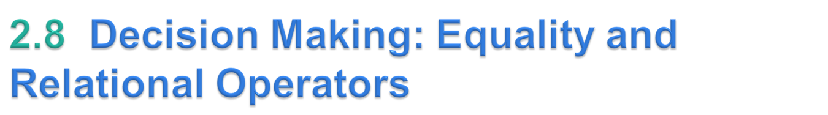
Condition
  An expression that can be true or false.
if selection statement
  Allows a program to make a decision based on a condition’s value.
Equality operators (== and !=)
Relational operators (>, <, >= and <=)
Both equality operators have the same level of precedence, which is lower than that of the relational operators.
The equality operators associate from left to right.
The relational operators all have the same level of precedence and also associate from left to right.
© Copyright 1992-2012 by Pearson Education, Inc. All Rights Reserved.

Slide 60
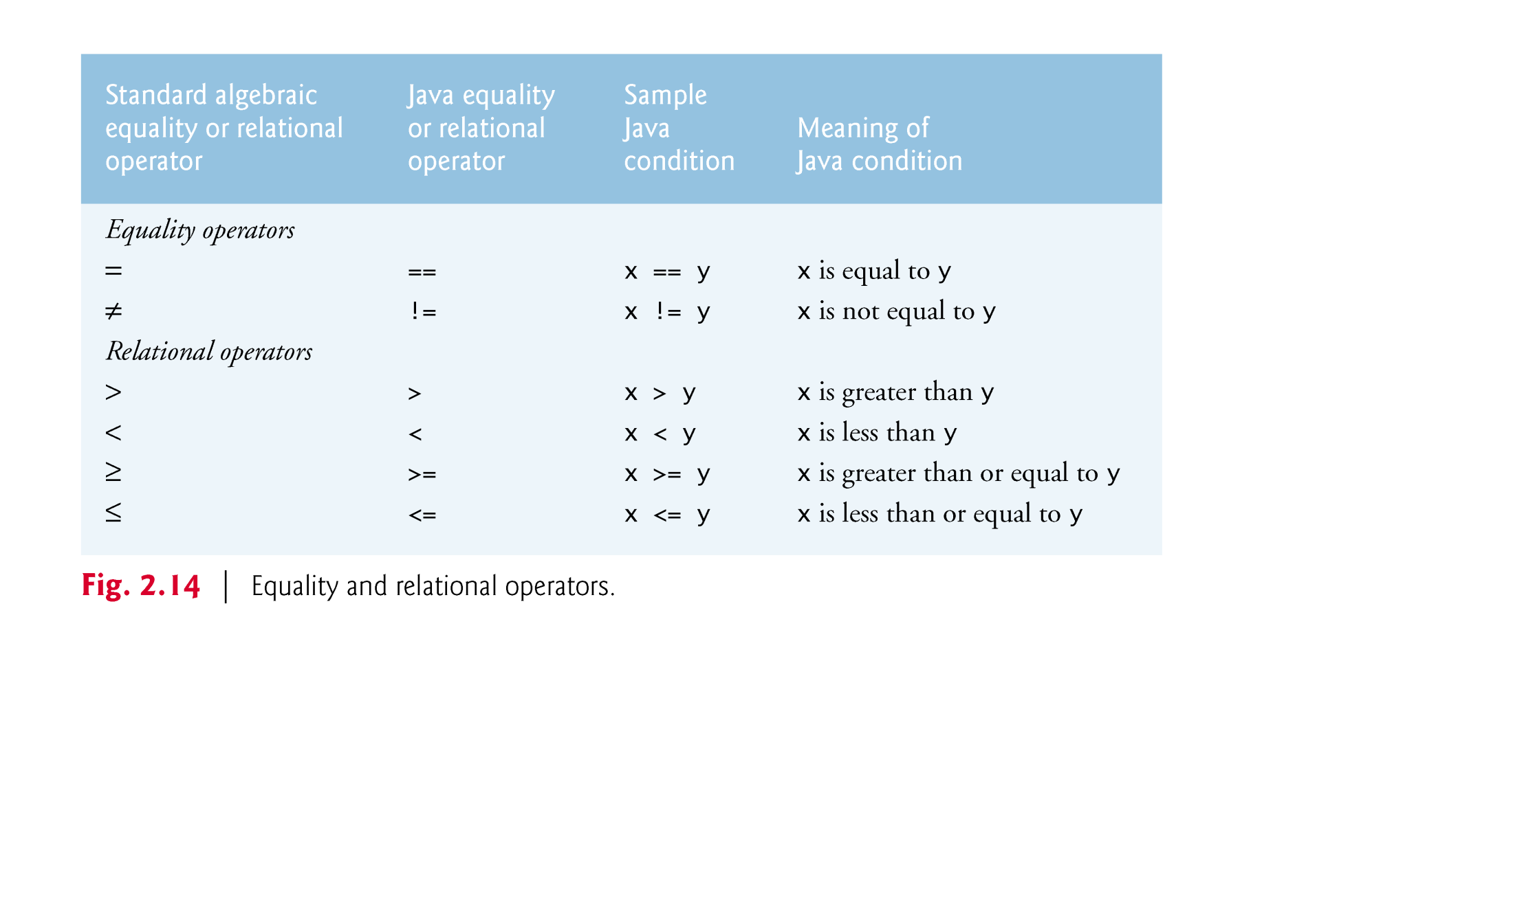
© Copyright 1992-2012 by Pearson Education, Inc. All Rights Reserved.

Slide 61
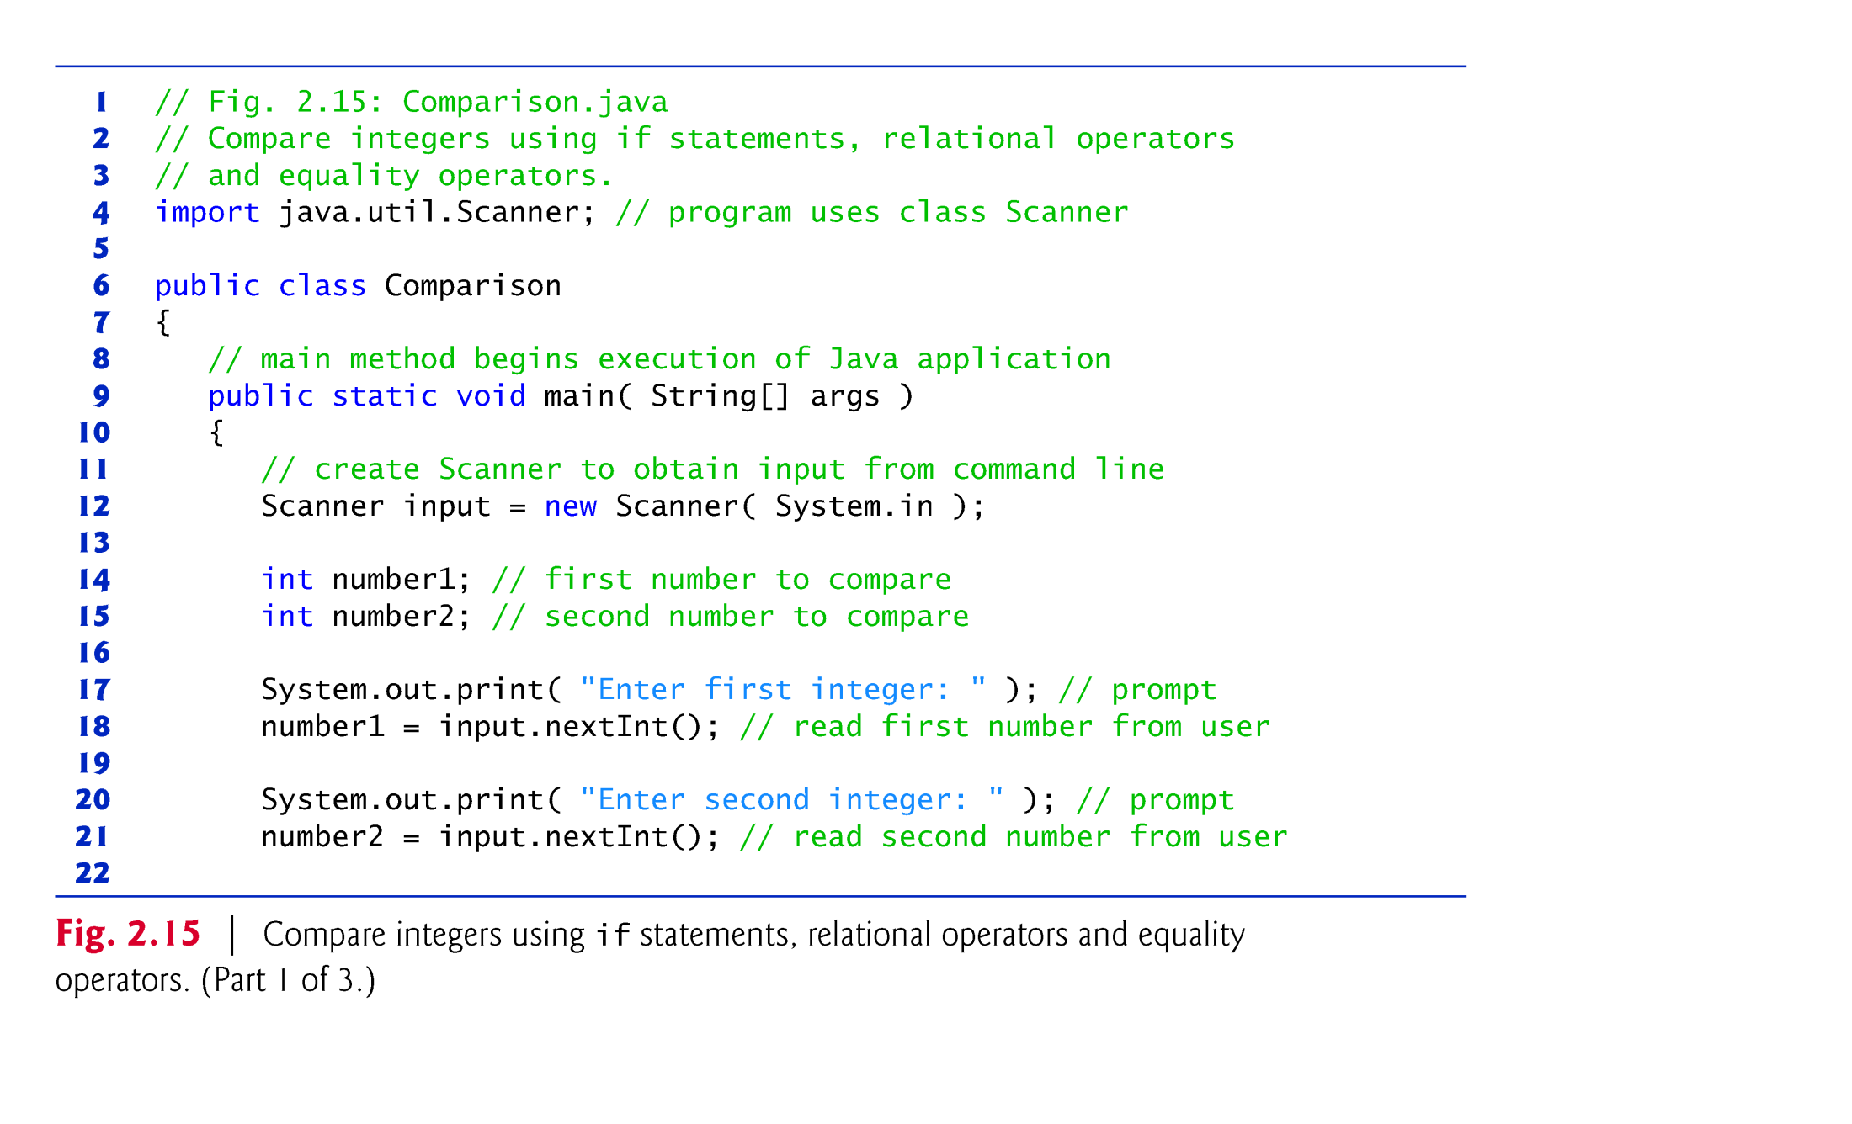
© Copyright 1992-2012 by Pearson Education, Inc. All Rights Reserved.

Slide 62
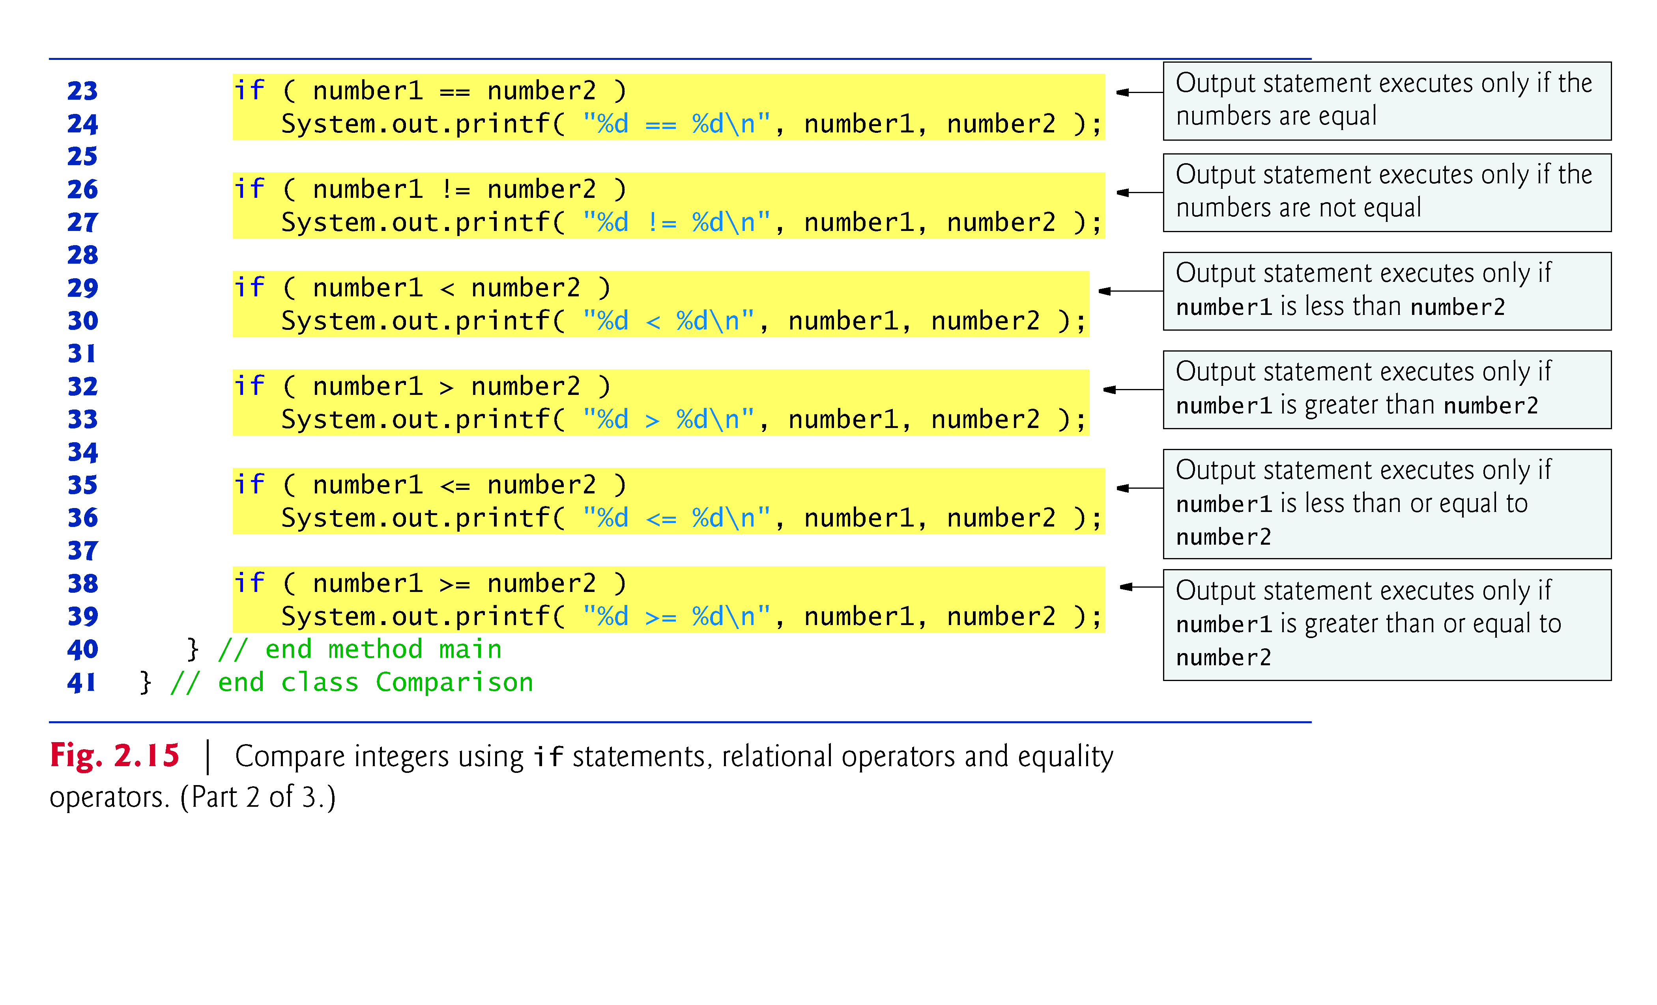
© Copyright 1992-2012 by Pearson Education, Inc. All Rights Reserved.

Slide 63
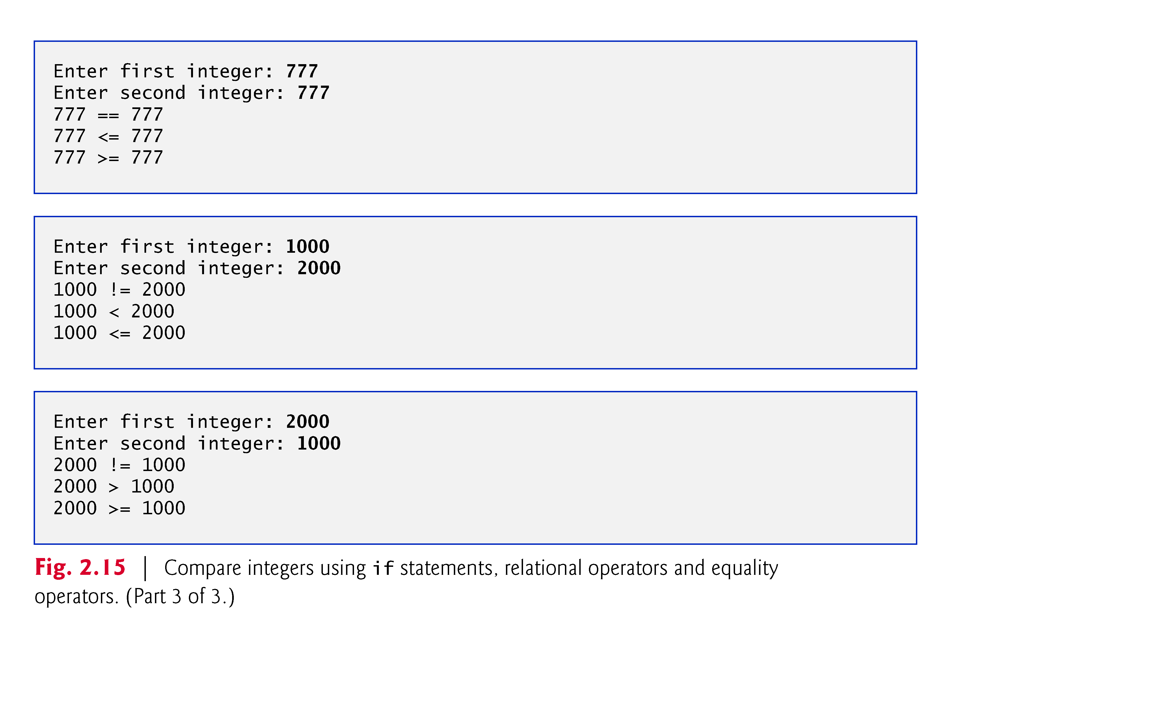
© Copyright 1992-2012 by Pearson Education, Inc. All Rights Reserved.

Slide 64
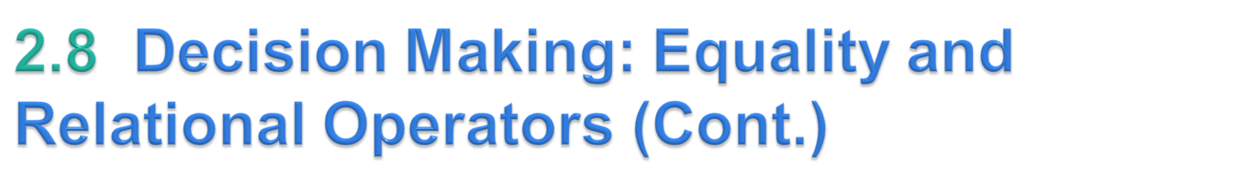
An if statement always begins with keyword if, followed by a condition in parentheses.
  Expects one statement in its body, but may contain multiple statements if they are enclosed in a set of braces ({}).
  The indentation of the body statement is not required, but it improves the program’s readability by emphasizing that statements are part of the body.
Note that there is no semicolon (;) at the end of the first line of each if statement.
  Such a semicolon would result in a logic error at execution time.
  Treated as the empty statement—semicolon by itself.
© Copyright 1992-2012 by Pearson Education, Inc. All Rights Reserved.

Slide 65
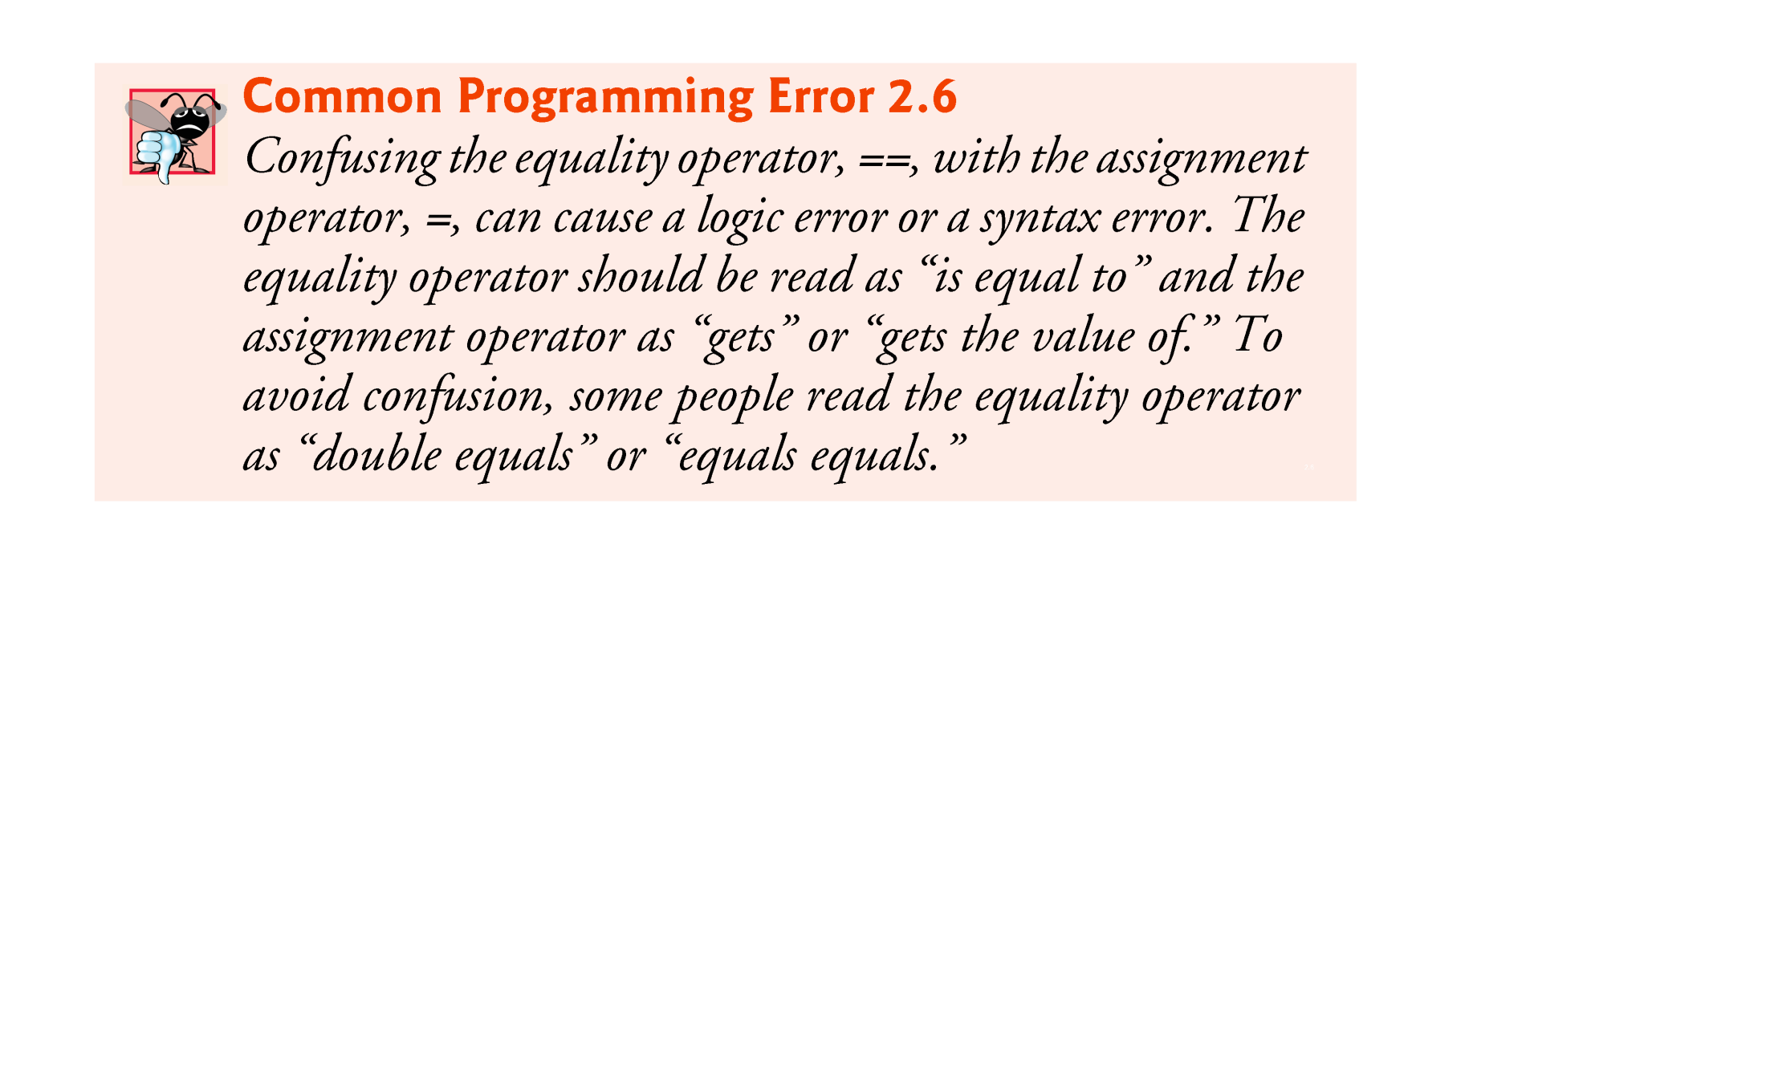
© Copyright 1992-2012 by Pearson Education, Inc. All Rights Reserved.

Slide 66

© Copyright 1992-2012 by Pearson Education, Inc. All Rights Reserved.

Slide 67
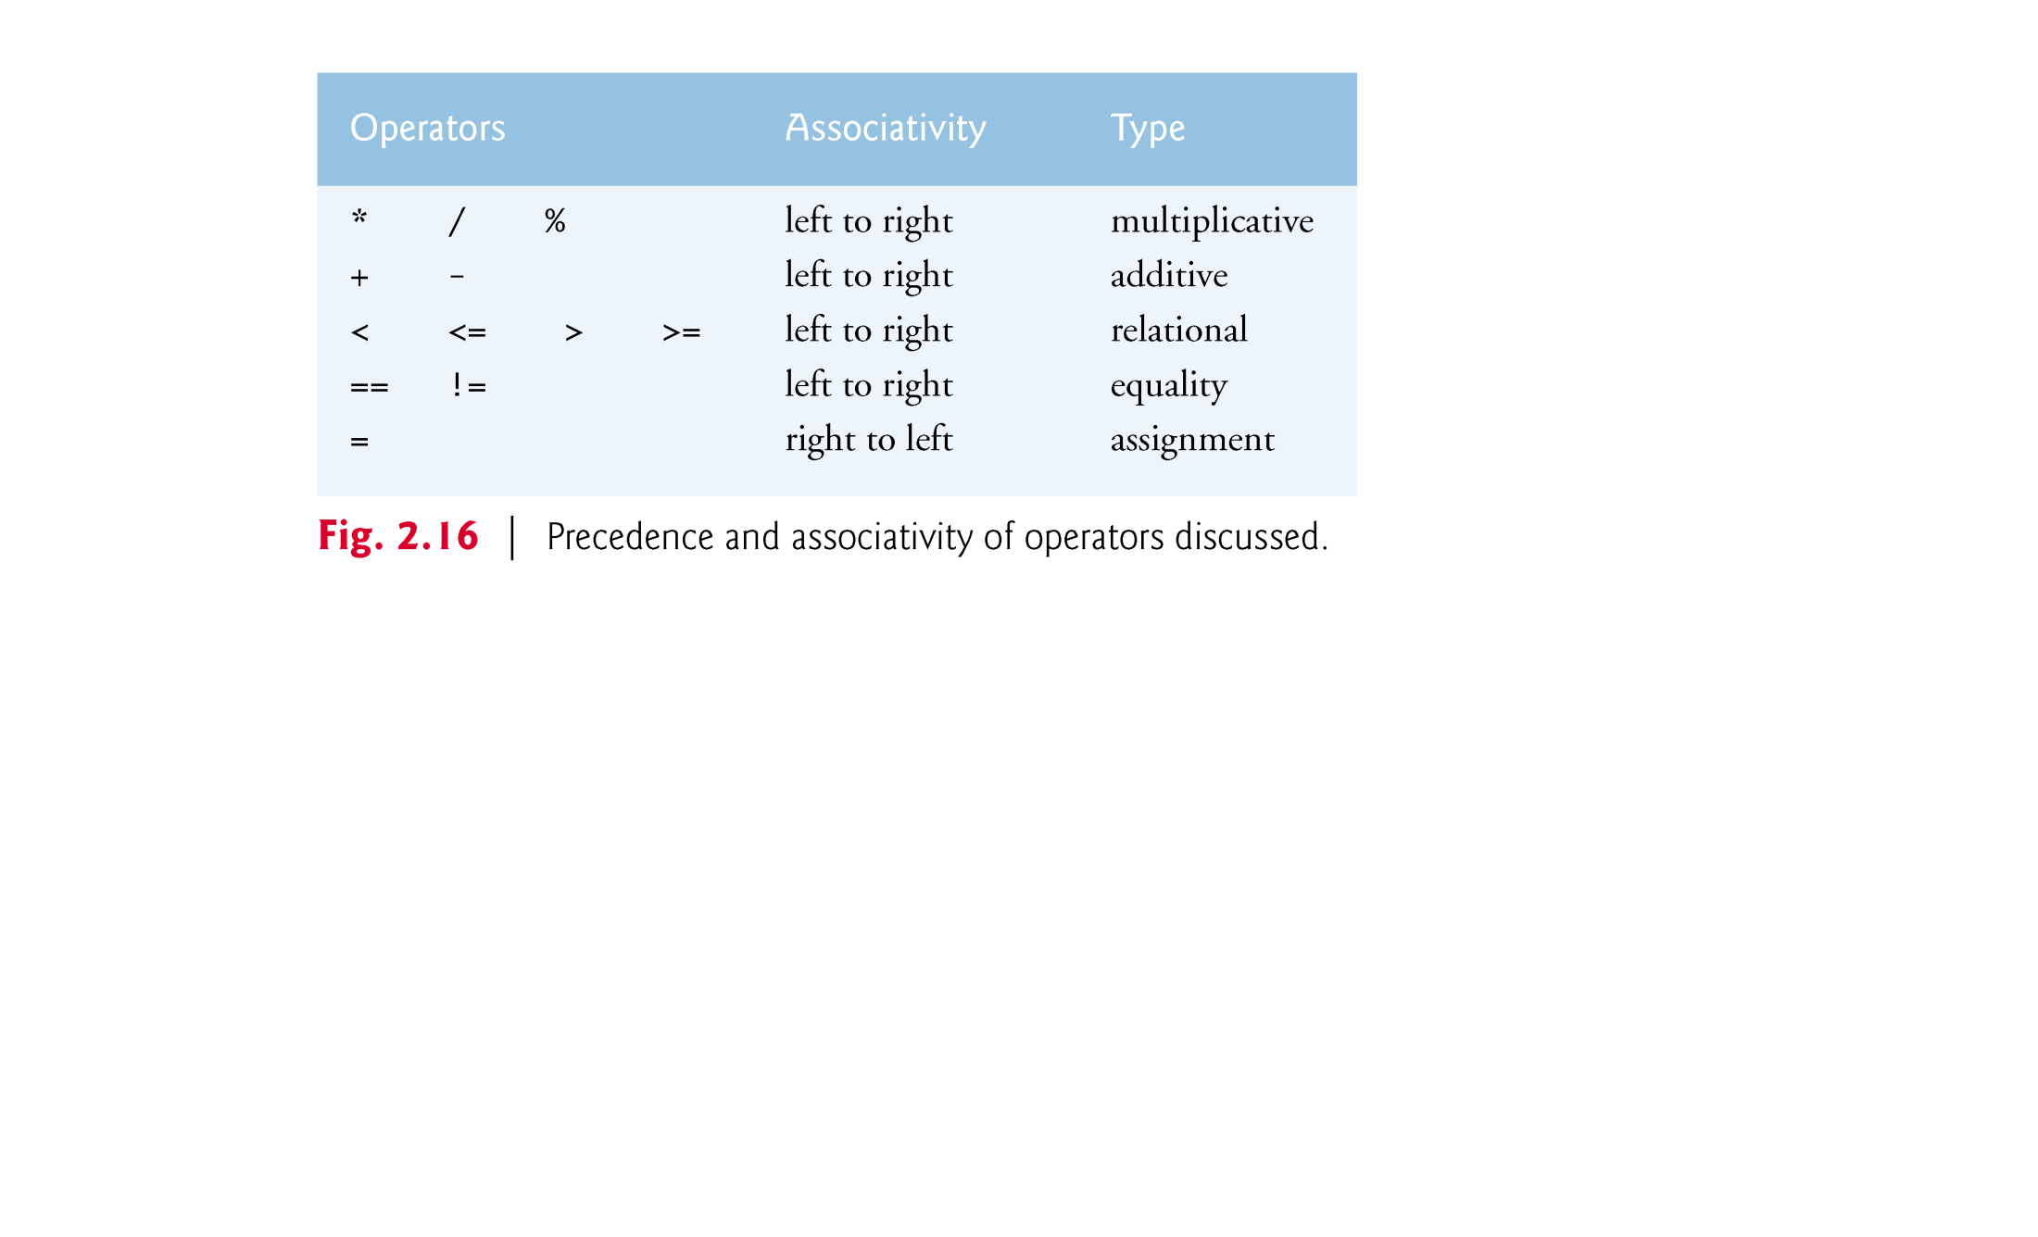
© Copyright 1992-2012 by Pearson Education, Inc. All Rights Reserved.

